Slide 1
District PLC
Growing Great Leaders through Distributive Leadership
Notes:
Hello, we are here from OCPS, the ninth largest district in the nation to highlight the work our district is doing to grow great leaders through a distributive leadership model that emphasizes building teacher and leader expertise.

Slide 2
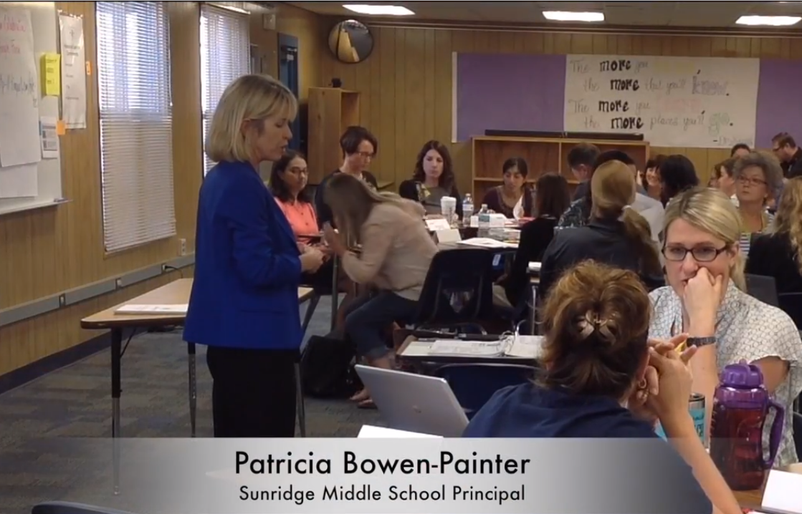
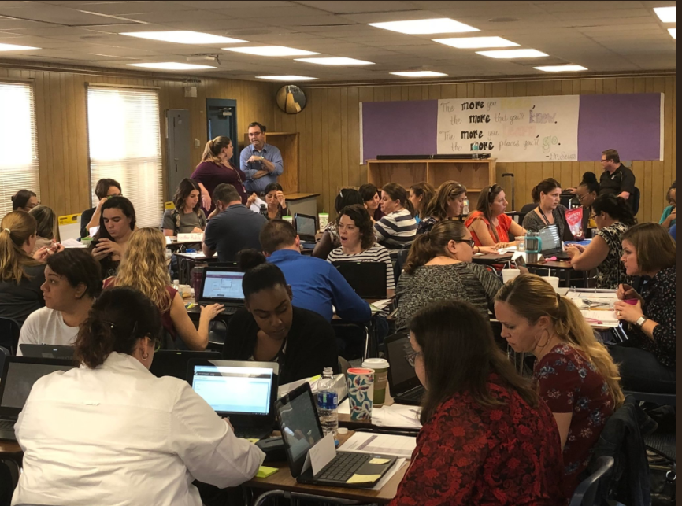
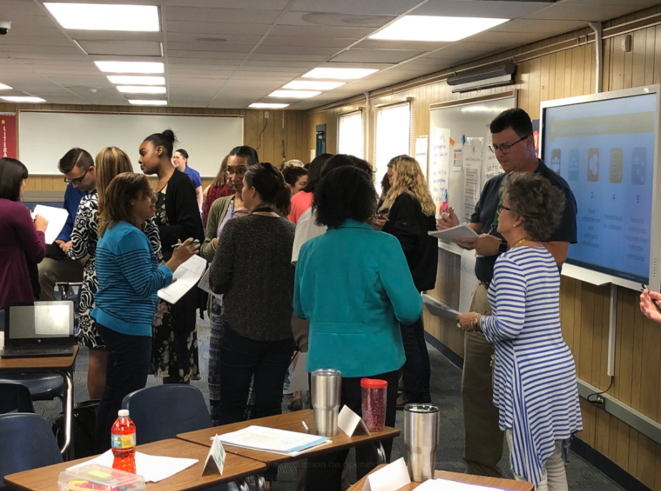
OCPS District PLC
Notes:
6 times each year over 1700 teachers, school leaders, and district personnel from more than 200 schools and departments will convene over a 5 day period to receive high quality professional learning related to essential content and leadership strategies and collaborate to develop plans of action to support increased collective efficacy and expertise.
You are looking at a picture of one of our principals who leads this work. 54 principal leaders have been identified to deliver a common training to a cluster of schools from the same geographic learning community, to ensure that all 200 schools in OCPS receive ongoing professional learning related to the district’s vision of instruction.
This is OCPS’s first time developing a clear professional learning continuum from classroom teachers to executive leaders all focused on the same content and leadership moves. This is not your typical train-the-trainer model, but instead a progression of learning that creates job-embedded supports at every school and in every department.

Slide 3
District PLC
Supports the improvement of teaching and learning, while building leadership capacity
Guides decisions, leads and monitors the school’s instructional program in order to increase collective efficacy
Creates a district-wide culture of high expectations for all students, teachers, and administrators
Notes:
The District PLC, also known as the DPLC, is a process that districts can use that supports the improvement of teaching and learning, while building leadership capacity through a clear district vision of instruction and distributive leadership. It reinforces the work districts are doing related to developing instructional leaders through a sustainable leadership pathway from executive leaders to classroom teachers.
The DPLC guides school and district decisions, ensuring that a clear focus on leading and monitoring the school’s instructional program is taking place in order to increase teacher efficacy.
The DPLC also creates a district-wide culture of high expectations for all students, teachers, and administrators through common, centralized powerful practices.

Slide 4
Why DPLC?
81% of teacher responders believe their individual collaborative learning teams are healthy and use positive communication | 68% of teacher responders believe that the work of their collaborative learning team contributes to a positive school culture
Notes:
For close to a decade, OCPS has been researching and implementing the professional learning community process as a collaborative approach for inquiry-based professional learning. Historical data shows:
· 81% of teacher responders believe their individual collaborative learning teams are healthy and use positive communication
· 68% of teacher responders believe that the work of their collaborative learning team contributes to a positive school culture.
There appears to be a lack of transition from individual teams to the culture of school as evidenced by these data points. Throughout our DPLC journey, we learn strategies to help build and sustain a school-wide culture of trust.

Slide 5
Why DPLC?
Professional Learning During Collaborative Learning Teams
 | Teachers | Administrators
Data Analysis | 22% | 15%
Develop Lesson Plans | 32% | 86%
Examine Student Work | 1% | 56%
Monitor Student Progress | 12% | 85%
Assessing Instructional Effectiveness | 11% | 56%
Notes:
Let’s take a look at the perspectives of teachers and administrators on the work of collaborative learning teams. According to district-wide survey results from 2016, teachers and administrators reported that teachers were engaged in professional learning and work related to the PLC practices on the screen. The percentages you see listed are the percentage of respondents who indicated the professional learning that was taking place during collaborative team time at their school.
Some of the highest-yield strategies in order to support student achievement are examining student work, data analysis, monitoring student progress, and assessing instructional effectiveness. When analyzing the data, it became clear that there is a disconnect between the teacher and administrative perspectives on the type of work collaborative teams are engaged in.

Slide 6
Why DPLC?
Percent of Students Meeting State Standards
 | 2014-15 | 2015-16 | 2016-17
English Language Arts | 54% | 54% | 55%
Mathematics | 52% | 52% | 53%
Percent of Students Meeting Learning Gain Requirements
 | 2014-15 | 2015-16 | 2016-17
English Language Arts | N/A | 52% | 54%
Mathematics | N/A | 54% | 52%
Notes:
As a district, our data has reached a plateau over the past 3 years. We must consider why this is occurring and how we can help support this. We know that many of the skills required to reach mastery of our standards require deeper analysis. As a district, we needed to do something different to make change for our students.
The data from these 3 previous slides highlights why OCPS uses the DPLC process. Let’s take a closer look at the systems we use to support this work.

Slide 7





DPLC Structure
Principal Supervisors
Monitor and support implementation; provide input to Design Team
Design Team
Develops content for sessions; shares content expertise with Principal Supervisors
Vision Setting Groups
Defines and guides the work of the DPLC
Principal Facilitators
Schools
Notes:
As we began this work, it was critical to establish a structure for development, learning, implementation and monitoring of professional learning. OCPS uses the structure on the screen to support the work of the DPLC.
There are three critical district level groups that support the DPLC Structure:
Vision Setting groups like a steering committee, Chief Academic Office planning team, and a strategic planning group
A Design Team, comprised of content, pedagogy, and leadership experts from a variety of backgrounds to develop professional learning content
and Principal Supervisors, who monitor, support, and provide feedback on DPLC implementation
The vision setting groups establish the vision and conditions required for success. These vision setting groups work with the Design Team and Principal Supervisors to develop and refine content. Principal Supervisors monitor and support the implementation of DPLC professional learning at school sites.
To support school-wide implementation of professional learning, principal facilitators who lead the professional learning for a cluster of schools are identified. These principal facilitators train other principals and DPLC teams from each school on DPLC professional learning, who then in turn deliver this content back at their school sites.
Now that we have an understanding of the DPLC Structure, let’s take a look at how OCPS established the vision of the DPLC.

Slide 8


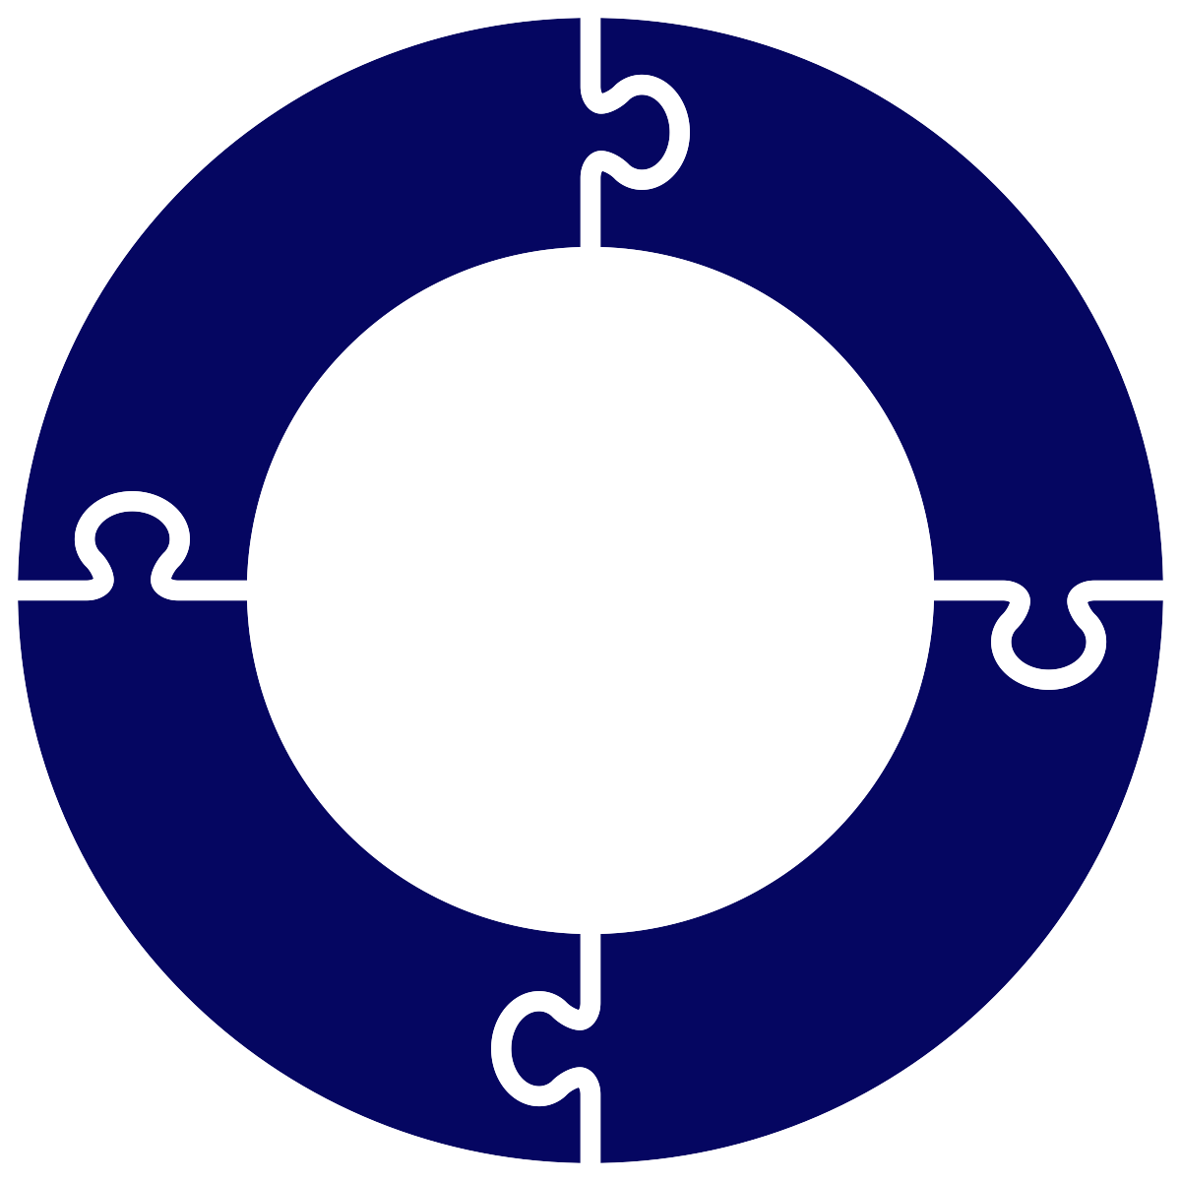
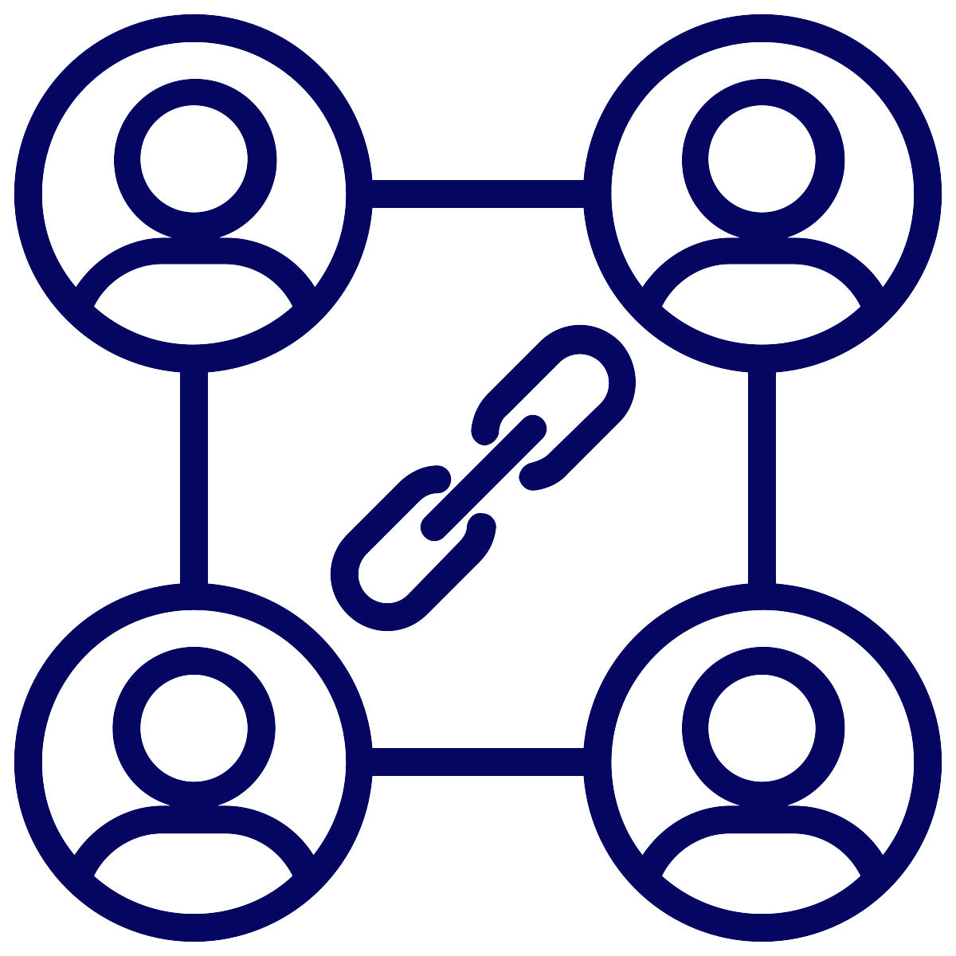

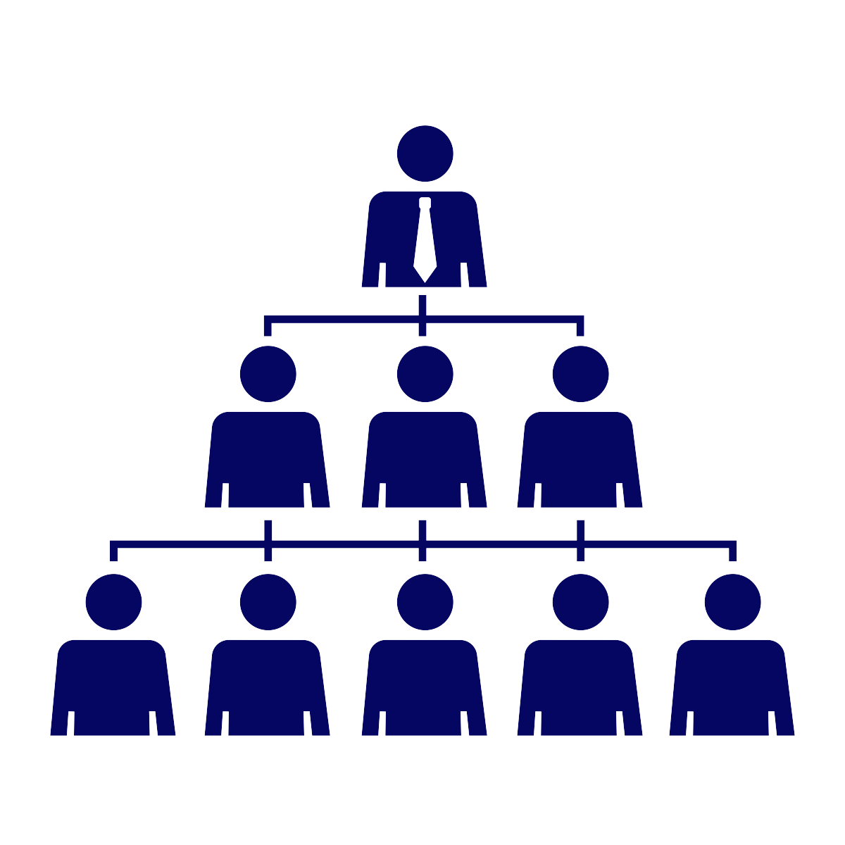



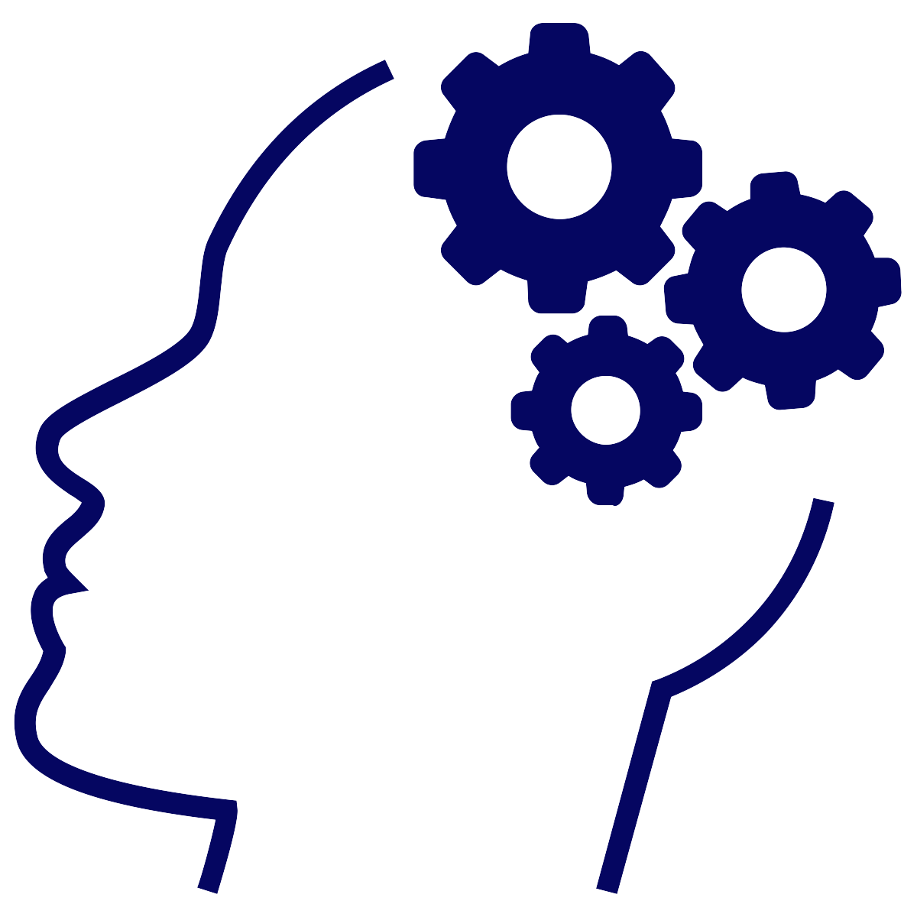
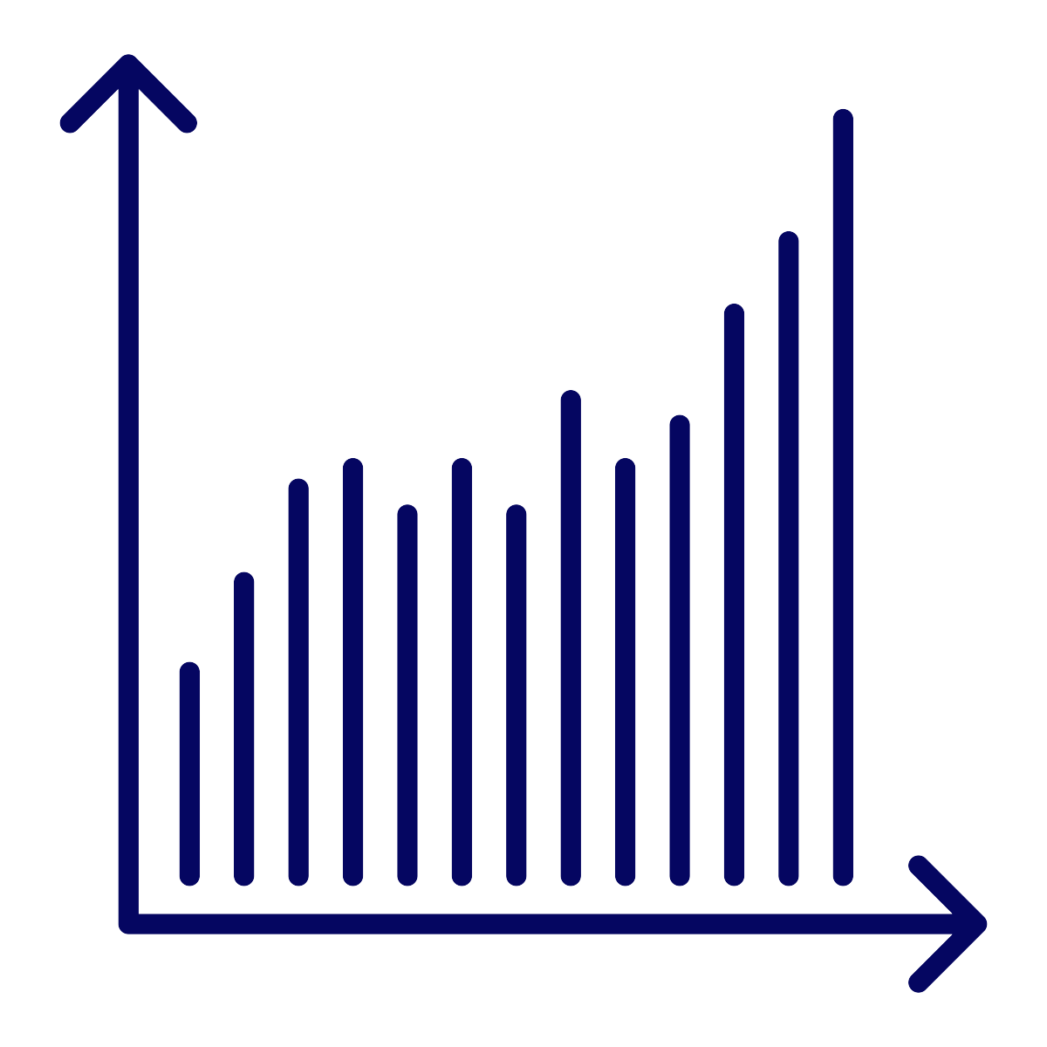
If...
...Then
Centralized
Process
Adherence to Principles & Processes
Sustained Collaborative Culture
Cultivated the Vision of Instruction
Distributive Leadership
Culture of Learning and Collaboration
Increased Job Satisfaction & Retention
Efficacy
Expertise
Increased Leadership Capacity
Increased Student Achievement
Notes:
As a district, we have clearly identified the necessary conditions needed to reach our district’s vision of instruction. OCPS believes that if we:
Establish a centralized process of essential professional learning
Ensure that adherence to the principles and processes of the professional learning occurs
Use a distributive leadership model from executive leaders to classroom teachers
Work within a strong culture of learning and collaboration
Develop collective efficacy and expertise
Then, OCPS will have:
A sustained collaborative culture
Cultivated the vision of instruction across all schools
Increased job satisfaction and retention
Increased leadership capacity and expertise
Increased student achievement for all students
This frame helps to set the vision of the DPLC and focus for our district work. Let’s take a closer look at how this frame was used this frame to establish our 3 year goals.

Slide 9

DPLC - 3 Year Goals
Year 1
Use close reading strategies
Comprehend and persevere through content specific complex text
Vision
Year 2
Using close reading strategies, use complex texts as the basis for participating in rigorous discussions and responding to text-dependent questions
Use strategies and tools to organize their thinking to prepare for writing in response to complex texts, across all content areas
Year 3
Write with evidence in response to complex texts, across all content areas
Notes:
The If/Then frame establishes the vision of our DPLC. This Vision drives the work of professional learning throughout our district. OCPS has used this vision to establish 3 year goals for the DPLC. The goals were determined through the analysis of data to select an instructional target and identify district-wide powerful instructional practices. (CLICK)
On the screen you see our 3 year goals for the DPLC. As a district, OCPS selected the instructional target of literacy and powerful instructional practices of close reading, academic discourse, and writing in response to complex text.
We are moving from a focus on close-reading and complex text during this year to writing in response to complex text in year 3. While focusing on these 3 content goals, we will also be engaged in professional learning related to the leadership moves that are necessary to help support and sustain high-performing professional learning community teams that are dedicated to support student achievement.
Once our vision and goals were established and the DPLC structures were planned, it was time to transition into the work of developing, learning, implementing, and monitoring our powerful practices.

Slide 10
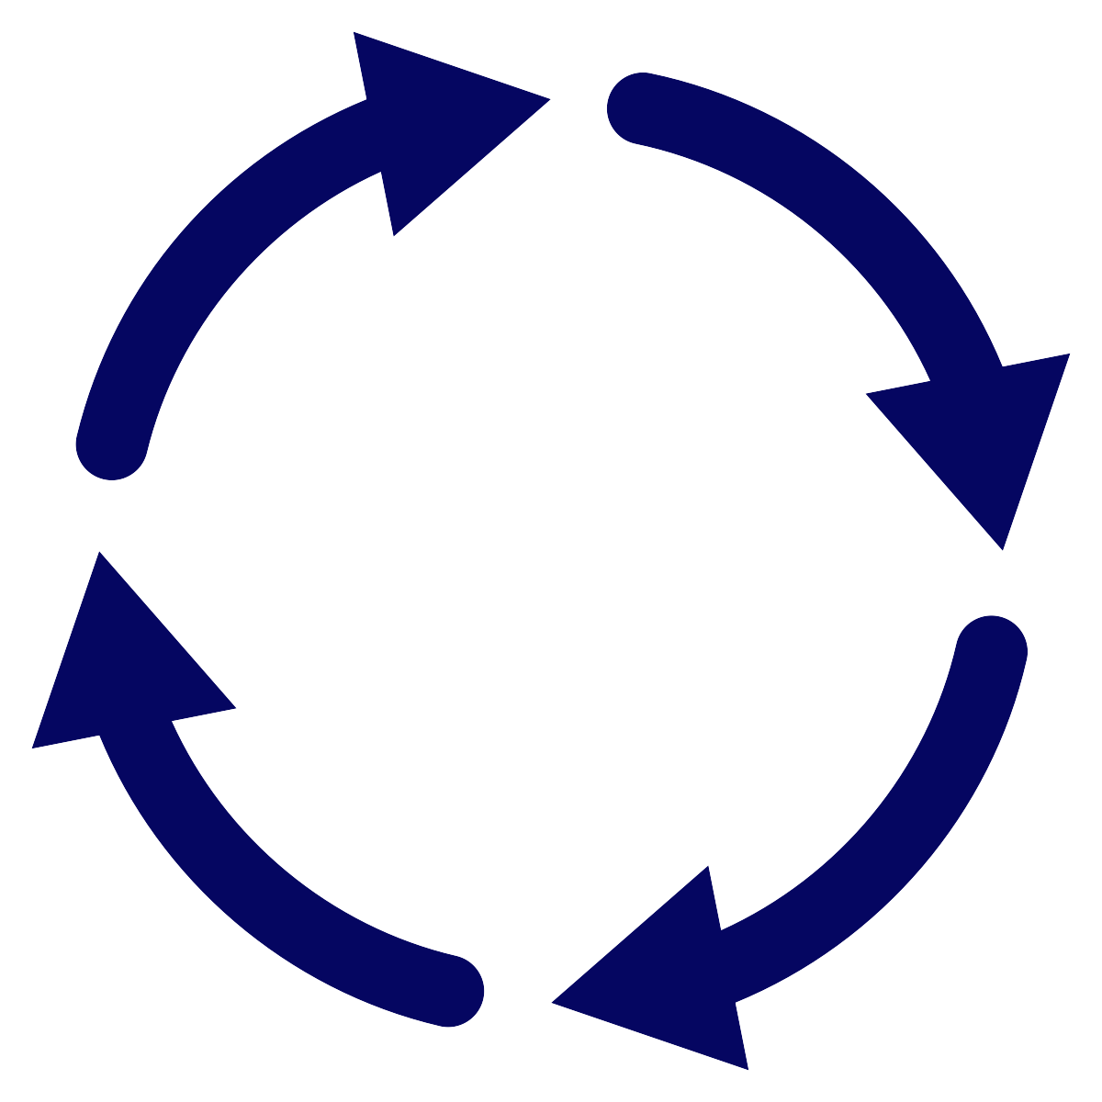
Monitoring
Development
Vision
Implementation
Learning
Notes:
OCPS uses the professional learning cycle on the screen to develop high quality professional learning though the DPLC, centered around our established vision. This cycle is constant, and used to develop content, engage in learning, implement learning, and monitor implementation of each DPLC session content.
Let’s take a closer look at each of these professional learning cycle components and how OCPS uses these stages to support principal expertise through the DPLC.

Slide 11
Development
Create organization and support for principal facilitators
Create a system for implementation of distributive leadership
Ensure content reflects responsive facilitation & powerful practices
Identify and create examples and exemplars of powerful practices
Refine content with feedback
Notes:
At the development stage of the professional learning cycle, OCPS has created systems of organization and support that deepen school leaders expertise in the areas of responsive facilitation, distributive leadership, and powerful literacy and leadership practices based on the vision established and the conditions required to reach our district vision.
Here are some examples:
Principal Facilitators are selected by principal supervisors to lead a cluster of schools within their learning communities
Design Team develops content around the powerful practices, utilizing strategies of responsive facilitation
OCPS identifies and creates job-embedded exemplars of the powerful practices to ensure a consistent understanding of the professional learning they will experience through video examples of our students, teachers, and administrators engaging in the powerful practices embedded in session content
Data is collected during DPLC sessions and through school implementation that is used to refine content in future sessions, supporting the mindset that professional learning in an ongoing process. These refinements are highlighted shared at each principal facilitator training
The content design and responsive facilitation techniques shared build capacity in our school leaders to support their work as instructional leaders. As professional learning cycles continue, our principals are provided opportunities to expand their leadership tool kits with strategies that will transcend the work of our DPLC.

Slide 12
Learning
Support facilitators through targeted learning experiences
Focused on literacy and leadership practices to maximize the potential of all employees
Occurs in a collaborative environment
Notes:
At the learning stage of cycle of professional learning, learning occurs at multiple levels of the DPLC structure.
After content is developed by the design team, a model is used to both train principals facilitators on the DPLC session content and allow them to learn responsive facilitation techniques. These targeted learning experiences highlight key professional learning facilitation strategies, provide exemplars of the professional learning content, allow for learning from colleagues while fellow principal facilitators model key literacy and leadership training components, and provide opportunities for collaboration with fellow principal facilitators and principal supervisors.
Principal facilitators then engage clusters of schools in this professional learning during the DPLC sessions. These professional learning opportunities are aligned to the leadership and literacy practices necessary to create the conditions required to reach our district vision of instruction and maximize the potential of all employee. Strategic collaboration opportunities are used throughout the learning process to promote the exchange of ideas between schools.
Professional learning for principal facilitators on how to facilitate builds expertise of these principals in essential instructional leadership techniques that can be used to sustain and support the district’s vision of instruction. All principals engage in the turn-key professional learning utilizing these techniques which helps to ensure that these facilitation best practices are extended district wide.

Slide 13

Implementing
Transfer of centralized message through clear communication pathways to ensure adherence to principles and processes at the classroom level
Use of structures for opening up classroom practice to provide feedback and coaching opportunities
Provide web based resources for support
DPLC Team | School Site Team | Grade or Content Teams | Classroom Teachers
Notes:
At the implementation stage of the professional learning cycle, schools utilize a clear communication pathway to ensure that DPLC professional learning reaches all classroom teachers.
The DPLC team is the team that attends the DPLC sessions. Classroom teachers should represent the majority of this team, and the principal is a part of this team.
The School Site team is the broader team at the school which is charged with implementing the professional learning. This team will include essential staff members that may not attend DPLC sessions such as assistant principals or resource teachers. This team determines the mode and audience of the provided turn-key professional learning.
Grade or Content Teams are used as audiences for the implementation of the professional learning. Often times, peer teachers deliver the content to their grade level teams, who then are charged with collaboratively planning for and reflecting on the implementation of this professional learning. This ensures that all classroom teachers receive job-embedded professional learning relation to powerful literacy and leadership practices.
Once teachers have begun implementation of the professional learning, classroom practice is opened through strategic processes that allow for feedback and coaching opportunities. OCPS uses processes like Ghost Visits where the classroom environment is analyzed, peer observations, and instructional rounds to support implementation of professional learning.
To further enhance implementation of professional learning, all training materials are available digitally to increase accessibility through an online Canvas course. Discussion boards are used to help promote collaboration amongst schools on DPLC professional learning implementation.
These communication pathways and structures provide principals with exemplary practices for instructional change through a systematic process that can be replicated for school improvement purposes, in turn deepening their understanding of key leadership moves that support sustainable change.

Slide 14
Monitoring
Utilize protocols to collect and analyze school-wide trends and patterns to evaluate implementation of powerful practices
Utilize formal and informal monitoring tools for principal supervisors to evaluate implementation of powerful practices at the school and classroom level
Survey all teachers and administrators for pre- and post-learning process evaluation
Notes:
At the monitoring stage of the professional learning cycle, monitoring of DPLC professional learning implementation occurs at the school and district level.
Schools use protocols such as the Guided Visit to collect trends and patterns on DPLC professional learning implementation. Guided Visits have teams made up of instructional personnel collect non-judgemental evidence of implementation and include a data aggregation process that allows for trends and patterns to be analyzed. School teams use the collected data to modify their plans for implementation of DPLC professional learning. This protocol provides leaders with a clear framework for monitoring implementation of professional learning which can be replicated for other school improvement work.
Principal supervisors utilize a coaching tool and an evaluative observation tool to monitoring implementation of DPLC professional learning. The coaching tool focuses on identifying classrooms with low and high level of DPLC professional learning implementation for analysis and discussion, centered on common evidences of literacy and leadership practices. The formal observation tool relates to the school leader evaluation process and connects DPLC professional learning to identified leadership strategies for the district’s visions of instruction and school improvement efforts. Additionally, all school leaders were required to focus on continuous improvement of instruction for their personal professional growth plan, as that leadership element directly connects to the DPLC. This ongoing monitoring by principal supervisors ensures principal receive continuous feedback to enhance their leadership practice.
Pre and post learning surveys provide OCPS with a unique opportunity to gain feedback on DPLC implementation at the classroom and school level from all teachers and administrators. Additionally, this provides the district the opportunity to collect data on how the implementation of powerful practices impact school and district culture.

Slide 15
Monitoring
Development
Vision
Implementation
Learning
Notes:
This brings us back to the beginning of our cycle of professional learning. We use what information we gained from monitoring to help drive the next cycle and support this constant process.

Slide 16


Logic Model
If…
a centralized process of essential professional learning to address the quality of literacy instruction and collaborative culture is developed,
adherence to the principles and processes of the professional learning occurs in all schools,
a model of distributive leadership from executive leaders to classroom teachers is utilized,
transformative instructional leaders support a culture of learning and collaboration in all schools,
increased collective efficacy occurs in all schools,
increased expertise occurs in all schools,
…Then
a strong, cohesive, collaborative school culture of professional learning will sustain at every school.
the district’s vision of instruction will be cultivated in all schools.
increased job satisfaction and retention will occur.
leadership capacity will increase at each school site.
Significant increases in percentages of students achieving proficiency and meeting learning gain requirements across all disciplines will occur.
Inputs & Resources
Consultants
DPLC Steering Committee
Principal Supervisors
DPLC CAO Planning Team
DPLC Strategic Planning Group
DPLC Design Team
Principal Facilitators
DPLC Teams
School Site Teams
District personnel
School personnel
Budget/funding for substitute coverage, materials, contracts, etc.
Activities
The DPLC Steering Committee sets the vision of the DPLC.
The DPLC CAO Planning Team and DPLC Strategic Planning Group guide the work of the DPLC.
Principal Supervisors select Principal Facilitators.
Principals select DPLC Teams (Principal + 8 to 12 teachers) to attend sessions.
Design Team develops content for training and adjusts content and processes based on feedback from DPLC Peer Review Team.
Principal Facilitators, Principal Supervisors, and PDS Support Team are trained on the delivery of content.
Select district support personnel are trained to support Principal Facilitators during content sessions.
6 DPLC sessions are held each year.
DPLC teams present content at each school and facilitate implementation.
Principal Supervisors monitor progress at each school site.
Outputs
Cycle of Professional Learning submitted by each school, after each DPLC session
Implementation of professional learning from DPLC sessions at each school
Principal supervisors monitor implementation of DPLC professional learning at each school site
Schools collect school-wide trends and patterns of DPLC implementation through the Guided Visit process
Teachers and staff engage in collaboration centered around:
  Data analysis
  Lesson plan development
  Examine student work
  Monitor student progress
  Assess instructional effectiveness
Teachers implement literacy practices across content areas
Students utilize literacy practices across content areas
Notes:
Now that you have an understanding of the work of the DPLC, here’s how you can begin to plan for a similar process for your schools.
You can see the if/then statements we shared earlier bookending the inputs, activities, and outputs through our logic model. If you take a closer look at these sections, you will find information about our DPLC structure and cycle of professional learning infused across these 3 areas.
A logic model is a great place to start when planning for any large scale change. You have the OCPS DPLC Logic Model available as a handout.
Thank you all so much for your time as we highlight the work of OCPS to grow great leaders!

