Slide 1



Preparing Principals to Lead
P-12 Improvement
Lessons from Chicago
Southern Regional Education Board
April 27, 2018
Steve Tozer
University of Illinois Chicago

Slide 2
Thank You
Returning a favor
SREB role in Illinois school leader reform
  2007 State Policy Inventory
  SREB residency assessment criteria written into State law
  Illinois recognized for today’s school leader policies (also TN, KY)
  (Too soon to see statewide data student impact)

Slide 3
Chicago Public Schools
“. . . the worst school system in America.”
--U.S. Secretary of Education William Bennett, 1987

Slide 4
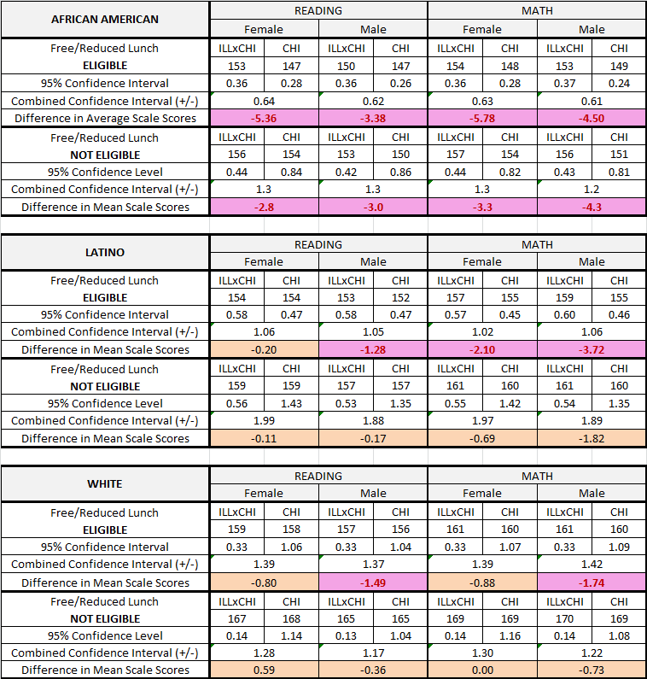
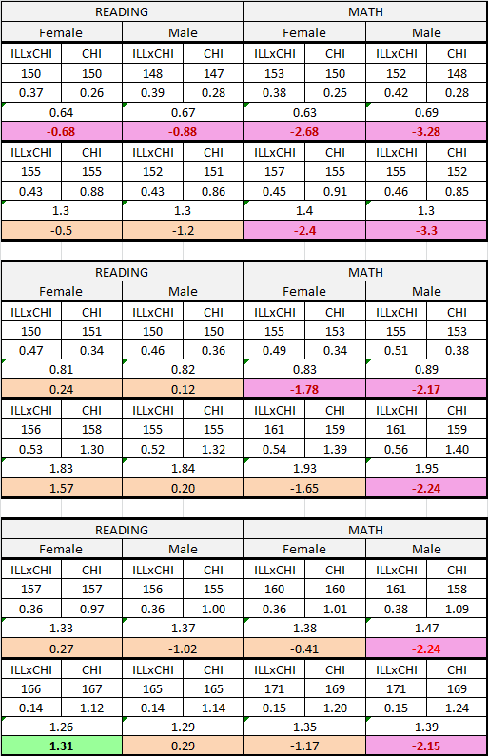
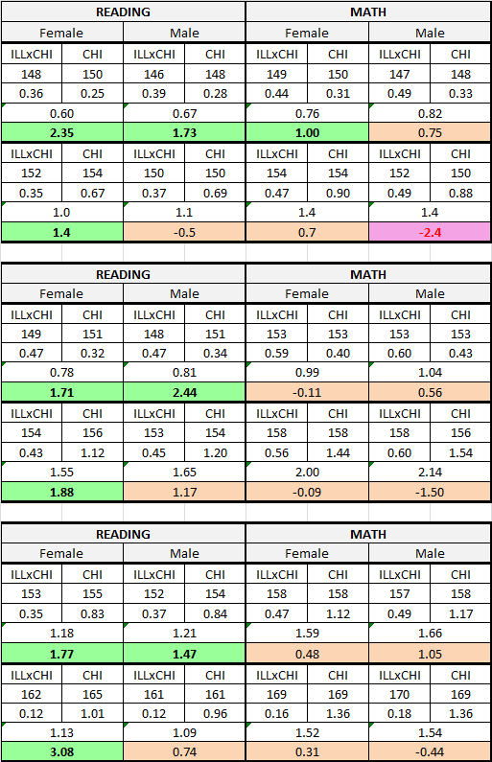
-
2001 ILXCPS v. CPS: Reading & Math
Grade 3 Grade 5 Grade 8
4

Slide 5
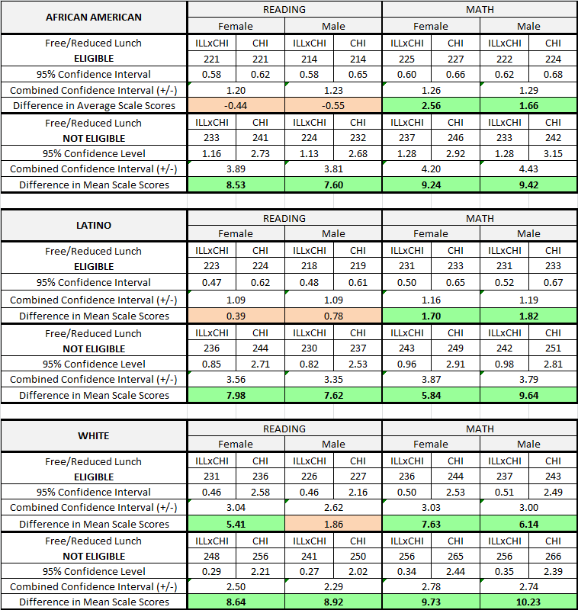
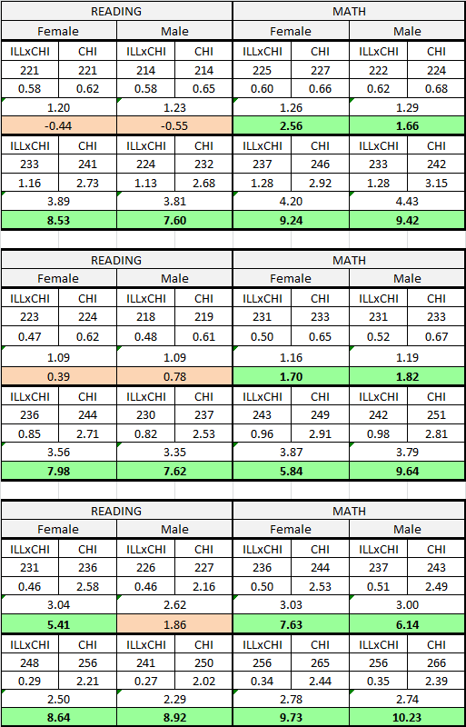
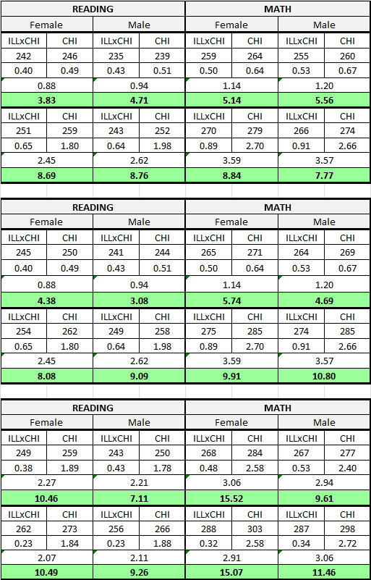
2012: ILX CPS Vs. CPS--Reading & Math
Grade 3 Grade 5 Grade 8
5

Slide 6
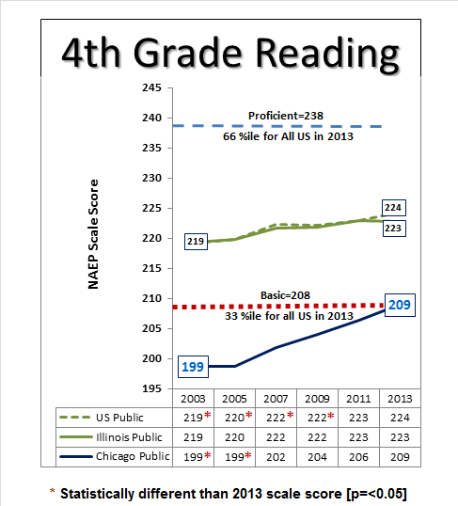
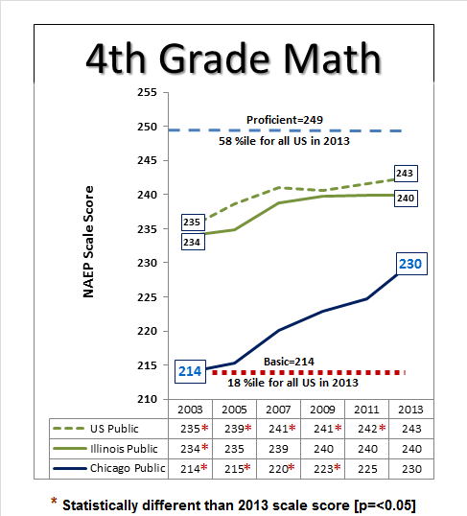
Since 2007 Chicago Has Accounted for
Almost All Statewide NAEP Gains
© Center for Urban Education Leadership
University of Illinois—Chicago

Slide 7
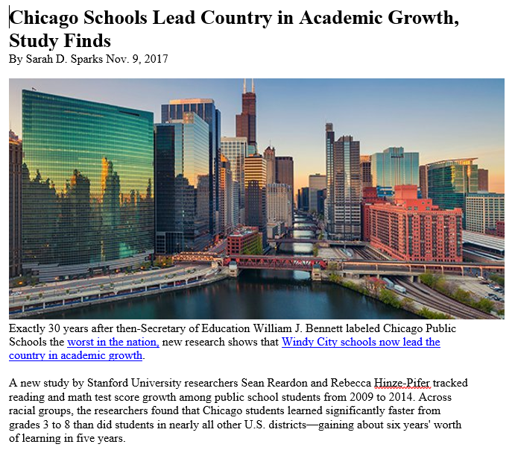
UIC
Making Good on the Promise of Public Education

Slide 8
Recent Media Attention
New York Times, Ed Trust, Wallace Foundation
https://www.pbs.org/newshour/show/new-chicago-schools-chief-faces-challenges-despite-major-strides
https://www.americanprogress.org/events/2018/03/28/448582/lessons-chicago-leveraging-leadership-community-partnerships/

Slide 9
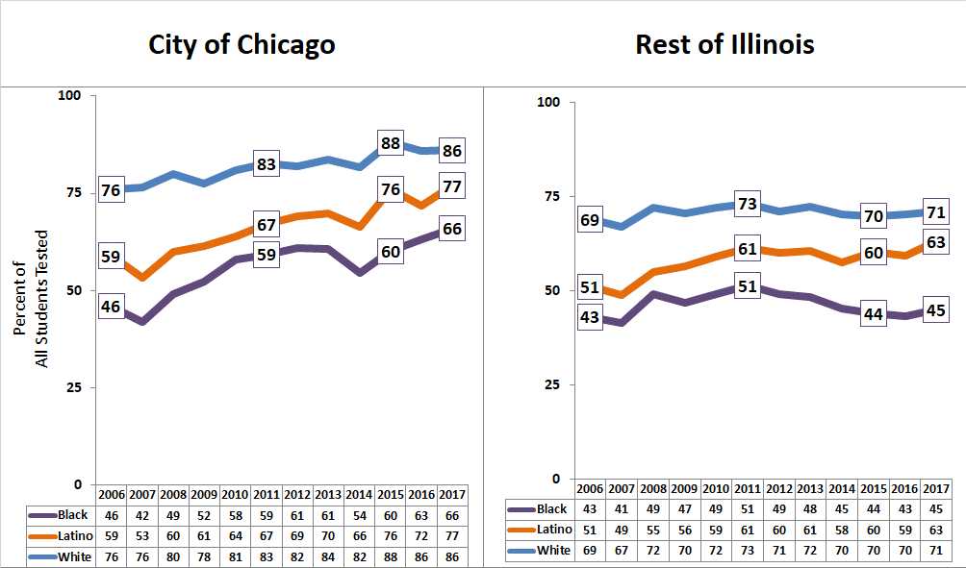
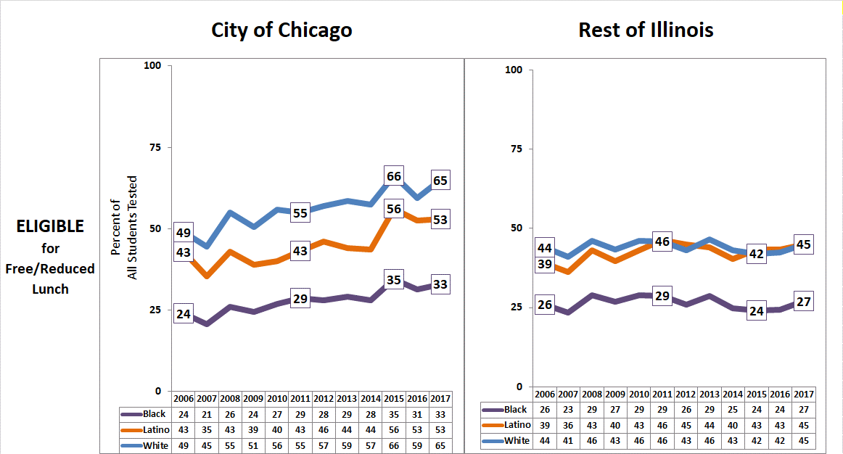
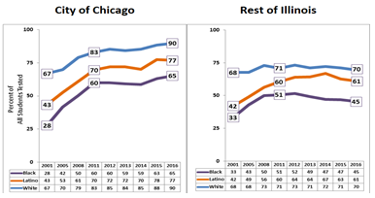
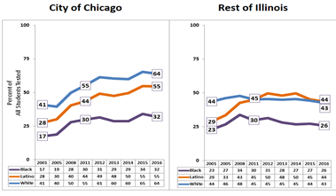
4th Grade Reading Grew in All Chicago Sub-Groups,
But Flat or Declining in the Rest of Illinois
Percent of Non-ELL Fourth Graders Scoring At or Above State of Illinois ISAT/PARCC Medians for READING/ELA: 2006 to 2017
ELIGIBLE
For Free/Reduced Lunch
City of Chicago Rest of Illinois
NOT ELIGIBLE
For Free/Reduced Lunch
City of Chicago Rest of Illinois
2017
2006
2006
2017
2017
2006
2006
2017
Black
Latino
White
Black
Latino
White
Black
Latino
White
Black
Latino
White
UIC
Making Good on the Promise of Public Education

Slide 10
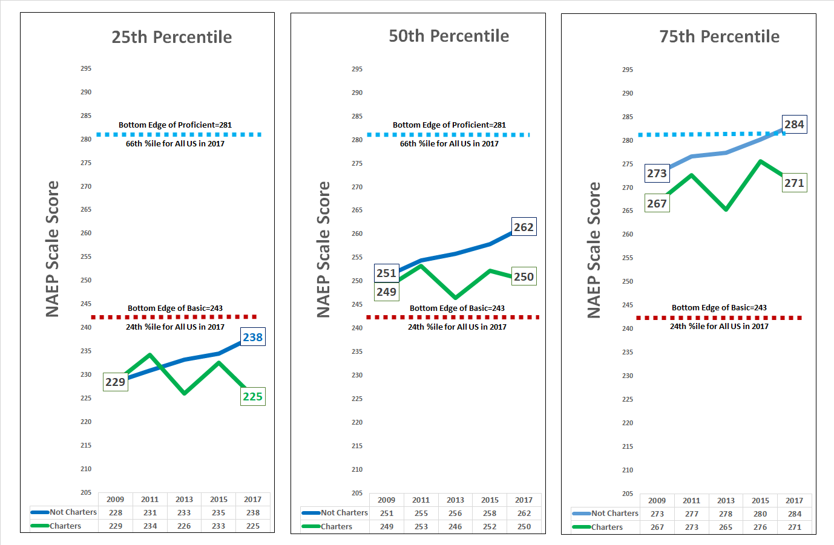
8th Grade NAEP Reading in Chicago: 2009 through 2017
Average Scale Scores at the 25th, 50th and 75th Percentile of Charter and Non-Charter Scoring Distributions
UIC
Making Good on the Promise of Public Education

Slide 11
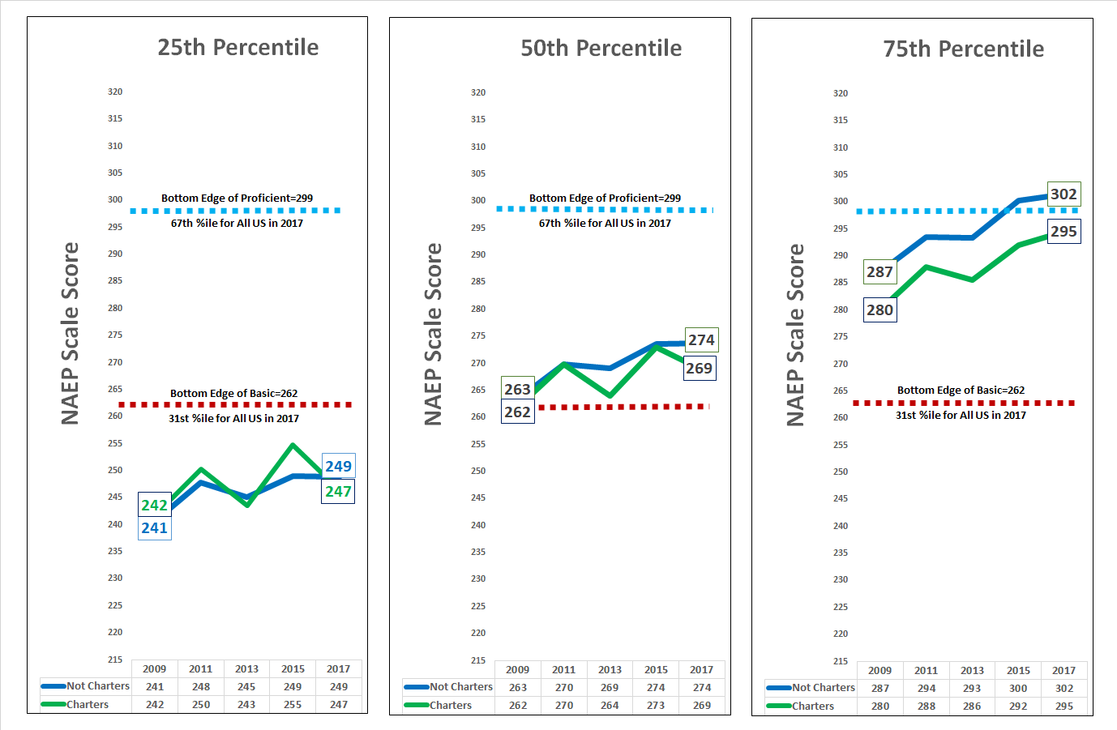
8th Grade NAEP Math in Chicago: 2009 through 2017
Average Scale Scores at the 25th, 50th and 75th Percentile of Charter and Non-Charter Scoring Distributions
UIC
Making Good on the Promise of Public Education

Slide 12
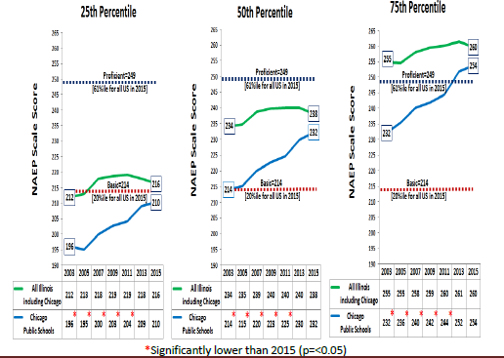
Achievement at All Levels Rises and Falls Together
Math Achievement: Chicago v. Illinois 2003-2015
NAEP Scale Scores over Time for 4th Grade Math at the 25th, 50th and 75th Percentile of the
Chicago and State of Illinois Distributions: 2003 through 2015
260
255
254
238
+22
234
232
232
+18
212
216
214
210
+14
196
UIC
Making Good on the Promise of Public Education

Slide 13
What Happened in Chicago?
Research ongoing (alternative explanations?), BUT:
Chicago’s 22-year investment in school leaders
Theory/research on how principals improve schools
Growing evidence on how to prepare such principals
Sustained evidence that schools led by next-generation leadership programs are improving faster than system as a whole
Al

Slide 14
“The School is the Unit of Change”
“and the principal is the leader of that change”--CPS
1996: New state law for CPS Principal Eligibility leads over time to “CPS Principal Competencies”
By 2002, three experimental models for funded residency programs for principal prep (CPAA, NL, UIC)
Tension between mayoral control and local school autonomy places premium on quality school leaders
Principals have high autonomy, high accountability
System of Network Chiefs for principal supervision and development

Slide 15
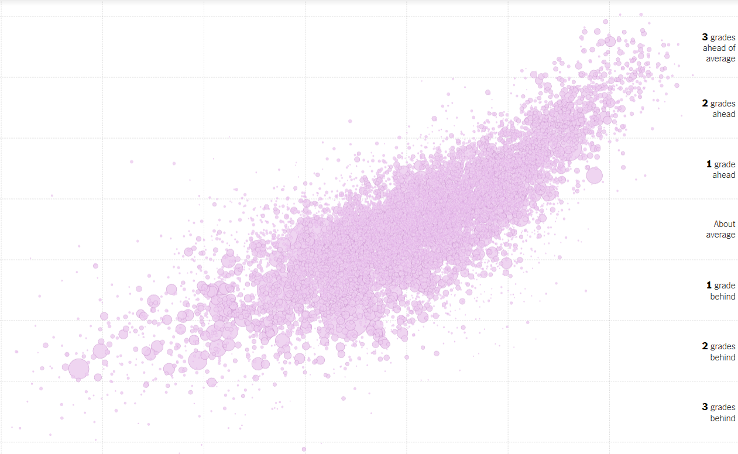

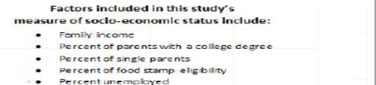
3,000+ American School Districts
From Reardon, Kalogrides and Shores (2016) “The Geography of Racial/Ethnic Test Score Gaps” Center for Education Policy Analysis at Stanford
SOURCE: Rich, Motoko, Cox, Amanda and Block, Matthew. “Money, Race and Success: How Your School Compares” in The Upshot, New York Times April 29, 2016 at https://www.nytimes.com/interactive/2016/04/29/upshot/money-race-and-success-how-your-school-district-compares.html?action=click&contentCollection=upshot&region=rank&module=package&version=highlights&contentPlacement=1&pgtype=sectionfront&smid=tw-upshotnyt&smtyp=cur&_r=2
UIC
Making Good on the Promise of Public Education

Slide 16
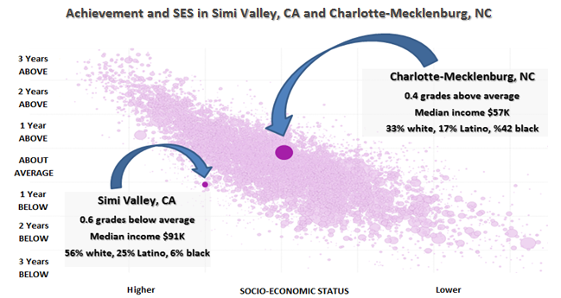
SOURCE: Rich, Motoko, Cox, Amanda and Block, Matthew. “Money, Race and Success: How Your School Compares” in The Upshot, New York Times April 29, 2016 at https://www.nytimes.com/interactive/2016/04/29/upshot/money-race-and-success-how-your-school-district-compares.html?action=click&contentCollection=upshot&region=rank&module=package&version=highlights&contentPlacement=1&pgtype=sectionfront&smid=tw-upshotnyt&smtyp=cur&_r=2
UIC
Making Good on the Promise of Public Education

Slide 17
Root Cause: Within-school Improvement of Student Learning
Within-school Improvement of Student Learning (explicit theory of impact)
Administrative
Leadership
Instructional
Leadership
TEAM
(P-3)
Organizational
Capacity
(P-3)
Teaching/
Instruction
(P-3)
Student Engagement and Learning
(P-3)
Cosner 2014; CCSR, 2006
A World-Class Education, A World-Class City
Notes:
17

Slide 18
What is School Organizational Capacity?
Bryk, Sebring, et al (2010) Organizing Schools for Improvement (Essential Supports: Implicit theory of impact, now assessed yearly in every Illinois school)
School Leadership
Professional Capacity
Parent Community School Ties
Student Centered Learning Climate
Instructional Guidance
A World-Class Education, A World-Class City
Notes:
18

Slide 19
Conventional View
Improved
Student
Outcomes
Improved
Instruction
High Expectations
Observation, Supervision, PD & Evaluation
Leadership
Behaviors
UIC
Making Good on the Promise of Public Education

Slide 20
UIC View
Improved
Student
Outcomes
High Expectations
Improved
Instruction
Observation, Supervision, PD & Evaluation
Improved
Organizational
Capacity
Leadership
Behaviors
UIC
Making Good on the Promise of Public Education

Slide 21
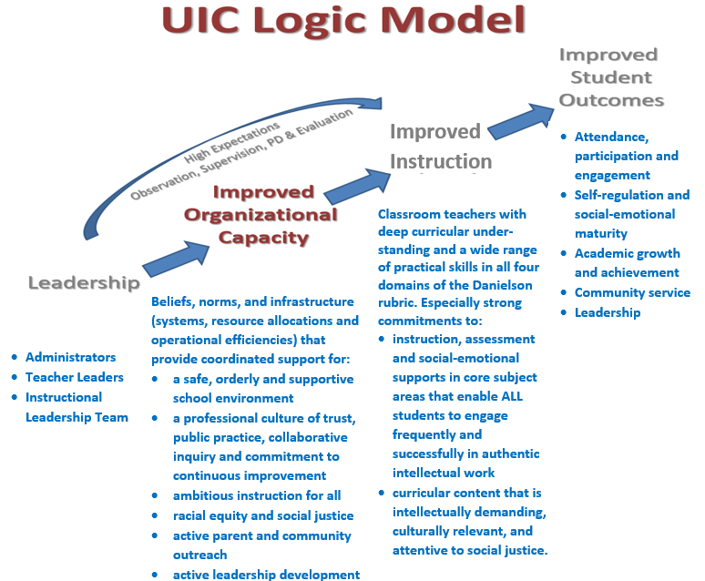
UIC
Making Good on the Promise of Public Education

Slide 22
Statement of the Problem
No higher education program was routinely producing principals who led schools to student performance outcomes that were not predicted by SES indicators. Sub-problems include:
It had been documented that an outstanding school leader could lead a school to “outlier” results, but principal preparation programs were not learning systemically from those outliers
No program was known to be using ambitious measures of program effectiveness that would inform continuous improvement, including such measures as % of graduates becoming principals, percent exceeding average retention rates, impact on student learning measures, including test scores and graduation rates.

Slide 23
What Does It Take to Develop Such Principals?
UIC in 2002: What would it take for a higher education institution routinely to prepare principals who lead urban schools to significantly improved student learning outcomes?
Chicago Public Schools (CPS) pays each full-year residency salary
Traditional master’s certification program replaced by Ed.D.
Students selectively admitted into annual cohorts of 12-20 students
Illinois P-12 leadership endorsement after first 18 months
Full-time leadership coaches, practitioner faculty at UIC, provide coaching throughout the residency and 3 years post-licensure
Culminates in data-based case study of developing org capacity

Slide 24
Evidence after 14 cohorts of UIC Program
94% of UIC residents assume Principal or Assistant Principal positions in urban schools upon completion of residency
Of 190 residency completers, 122 have become urban principals
78% of UIC residents from first 12 cohorts have become principals
UIC and New Leaders together have produced over 300 principals for Chicago public schools since 2003
In a district with steadily rising school performance metrics, UIC and New Leaders consistently outperform district metrics: attendance, test scores,HS graduation rates, and principal retention
UIC and New Leaders principals now fill key leadership roles in CPS, including head of Chiefs (NL) and district CEO (UIC)

Slide 25
Characteristics of Next-Generation Principal Prep/Development Programs
Results-oriented focus on principal impact on schools
Partnerships with districts that invest resources
Highly selective admissions to structured cohorts
Full time, intensively coached, site-based learning (residencies, internships)
Integration of academic and practical learning
Structured post-licensure support to accelerate early-career development and success
DISTRICT AND STATE POLICY SUPPORTS

Slide 26
Cost-Effectiveness
There is no more cost-effective lever that we know of for improving students performance across all achievement levels—(unless it is universal Pre-K, which itself depends on high quality leadership)
CPS currently spends .3% of its budget on school leader pipeline programs (depending on what counts as principal-specific)
Currently, IHEs fund principal principal preparation below the level of teacher preparation on a per-graduate basis: this must change
For Illinois, for every principal preparation program (N=27) to offer full year residencies would be a “rounding error” on the state education budget (Illinois School Leader Task Force)

Slide 27
The challenge of improvement at scale
The scale of the principal preparation challenge is within our resources to address (approximately 10,000 principals annually, 400 in IL, 200 in TN?)
We are not yet organizing ourselves to address the problem of scale—across IHEs, districts, or states
The organizational challenge is systemic, requiring IHEs, districts, and the state to function together; and this almost certainly requires IHE and state leadership

Slide 28
Six Resources for Leadership Learning
Bryk, A. S., Sebring, P. B., Allensworth, E., Luppescu, S., & Easton, J. Q. (2010). Organizing Schools for Improvement: Lessons from Chicago.
Bryk, A., Gomez, L. et al. (2015). Learning to improve: How America’s schools can get better at getting better. Donaldson, G. (2008) How Leaders Learn: Cultivating Capacities for School Improvement
Ericcson, A. (2016) Peak: Secrets from the New Science of Expertise
Forman, Stosich, Bocala (2017) The Internal Coherence Framework.
Wiliam, D. (2016) Leading for Teacher Learning

Slide 29
Steve Tozer
UIC Center for Urban Education Leadership urbanedleadership.org stozer@uic.edu

