Slide 1
How College Access Programs Can Partner with Schools: What Professional School Counselors Want You to Know
Notes:
Domains represented in the activities that Counselors are involved in with our students at the elementary middle and high school level. You will see some information tonight that reflects back to these domains.

Slide 2
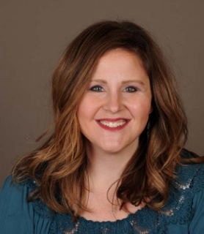
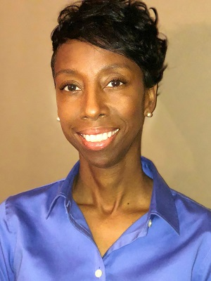
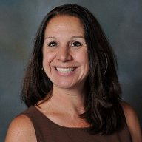
Today’s Panel
Dianne Thompson
Mindy Willard
Dawn Mann
Notes:
Domains represented in the activities that Counselors are involved in with our students at the elementary middle and high school level. You will see some information tonight that reflects back to these domains.

Slide 3
Overview for Today
Role of the School Counselor
What a Successful Partnership looks like
What School Counselors Need from Non-Profit Organizations, State Agencies, and Other Partners
Discussion and Q & A
Notes:
Domains represented in the activities that Counselors are involved in with our students at the elementary middle and high school level. You will see some information tonight that reflects back to these domains.

Slide 4
The Role of the School Counselor
School Counselors work with ALL students in these 3 domains
Academic
Study Skills
Test Taking Strategies
Goal Based Course Selections
Transcript Reviews
Tutoring Referrals
Grade Motivation
Academic and Career Plans
ACT Prep
Social/Emotional
Safe Schools
Depression
Anxiety
Suicide Prevention
Family Concerns
Relationship Issues
Friendship
Bullying/Harassment
Grief/Loss
Drug/Alcohol Use
Career
Academic and Career Plans
Post Secondary Plans
College Visits/Fairs
Career Interest Inventories
College Applications
Financial Aid
Scholarships
Letters of Recommendation
Internships/Apprenticeships
Job Shadowing
Average Ratios 482:1 Recommendation 250:1
Notes:
Domains represented in the activities that Counselors are involved in with our students at the elementary middle and high school level. You will see some information tonight that reflects back to these domains.

Slide 5
School Counseling is Comprehensive,
Programmatic and Proactive
Direct Services | Indirect Services
Direct services are in-person interactions between school counselors and students and include the following: | Indirect services are provided on behalf of students as a result of the school counselors’ interactions with others
School Counseling Core Curriculum 9th grade orientation Financial aid presentations to seniors College/Career Fairs Individual Student Planning Course selection College Applications Small Group Counseling Study Skills Group Anger Management Group Responsive Services Crisis Response | Referrals FAFSA Support Mental Health Tutoring Consultation and Collaboration Colleagues Teachers Families Community Based Organizations

Slide 6
School Counseling Programs are Data-Driven
Counselors disaggregate data by: | Ethnicity, Gender, Race, Free/Reduced, ESL status, Gifted, First Generation
Attendance Rates | Student Engagement | FAFSA Completion Rates
Office Referrals | Academic Achievement (Grades/Test Scores) | Postsecondary Completion Rates
Progression, Retention, Dropout/Graduation Rates | School Safety | Student Clearinghouse Data
Course Failures | Substance Abuse | Pre/Post Perception Data

Slide 8
Partnering with School Counselors

Slide 9
Effective Collaboration
Connects to the vision/mission/priorities of the school (district)
Knowledge of student demographics and school/district data
Understands the role of the school counselor/programming
Advocate for the counseling program/counselor role
Compliments school counseling programming, does not replace or upstage
Clear understanding of the project/partnership
Ongoing or one time event/opportunity
Systems for ongoing collaboration
Leadership and Facilitation
May involve multiple organizations
Mutual Understanding of organizations

Slide 10
Where to start
Become a Champion for School Counseling
Research the district
Review district data (Dept of Ed)
Strategic Plan
School Improvement goals
Raise awareness of your program’s vision and mission, programming and opportunities for collaboration
Present at school counseling conferences
Submit articles in school counseling publications
Reach out district level counseling supervisors and/or state leaders to start dialogue.
State School Counseling Association
Be a member of your state’s College Access Network
Don’t forget elementary and middle school students!
Notes:
Talk about the best way to approach a school counselor.
What would we consider a high quality partnership
Draw Connections to vision/mission of school district.
Reach out to School District/WSCA/WACAC
Help counselors see how their organization can support work they are already doing - know the demographics of the school
Support school counseling! Understand our role and help us see how you will support our work. Not do a better job of it or replace our work
Become a champion for school counseling. If you can compliment my work rather than replace my work or show how your organization can do a better job - I’m not listening.

Slide 11
Opportunities for Collaboration
College and Career Fairs
College Goal Events
Financial Aid Workshops
Individual Support
College Application Week/Bootcamps
AVID Programming
Senior Seminars
Job Shadowing Events
Professional development for counselors/staff
PD for your staff from counselors
Donate supplies/college swag
Mentoring
Family info nights
Collaborate with neighborhood organizations/churches
Provide funding for Prof. Dev.
Provide funding for/organize college visits for students or counselors
Classroom presentations on specific topics
Offer your facilities
Reach Higher College Signing Day
Host a Beating the Odds Summit

Slide 12
Opportunities for Professional Learning
Awareness
Comprehensive Approach (K--12)
Communication
Partnerships
State counseling organization
Local counseling organizations
Districts
State Department of Education
Professional Learning Platforms
Webinars
Where Counselors Hang...
Post-Secondary Data
Notes:
Organizations exist
What do you want SCs to know
Career Education starts in Kindergarten
Getting the information out
Partnerships and PL Platforms are interrelated

Slide 14
Contact Us
Alice Anne Bailey
@draabailey
alice@hustle.com
Mindy Willard
@mindywillard17
mjwillard@madison.k12.wi.us
Dawn Mann
@msdmannda ‏
dmann@doe.k12.ga.us
Dianne Thompson
dthompson@csdecatur.net

