Slide 1
How Principals Can Support Project-Based Learning as an Instructional Shift?
Randy Gooch
Career Technical Director
Columbia Area Career Center, MO
Marty Sugerik
TCTW School Improvement Consultant

Slide 2
Problem-Solving Design Process
&
Sample Workforce Comparisons
SREB Design Process | Engineering Design Process | Trouble-shooting Process | Web Design Process | Nursing Process | Life Cycle Design | Business Methodology | Scientific Method
Ask/Inquire | Identifying the problem | Diagnose the Problem | Initialization | Assess | Define Requirements | Define | Question
Imagine |  |  |  | Diagnosis |  | Measure | Research
Plan | Relevant Information | Find Possible Solutions | Visualization | Planning | Design | Analyze | Hypothesis
Create | Conceptualization | Take Action | Implementation | Intervention | Build | Develop | Test
Experiment/ Evaluate | Evaluation and Analysis | Evaluate and Analyze | Verification | Evaluate | Test
Improve |  |  | Gratification | Report | Implementation |  | Analyze
Communicate | Implementation | Deliver Final Product |  |  | Evolution | Deliver | Communicate

Slide 3
Project-Based Learning in Career Pathway Courses
Guiding Principles
Authentic and Relevant Projects: Projects are based on real workplace problems and require ongoing in-depth inquiry completed over an extended amount of time. Business/industry and postsecondary partners should be involved in the design of the project and in the review of project results.
Authentic Audiences: Projects should include various opportunities for students to interact with an authentic audience or as a mentor either through technology or in person. The audience should involve representative from a real workplace.
Teacher Collaboration: Projects should be planned collaboratively by CTE and academic teachers and planning should be continuous to link core academic content to math and science to completion of the project and delivered both by academic and career pathway teachers.
Project Design: Project design is based on three major areas of standards and skills:
1. Technical standards and skills — standards and skills are unique to the career field and mastered in career pathway courses.
2. State Academic college- and career-readiness standards (SCCRS) — state college- and career-readiness standards are embedded in the
project with a focus on literacy, mathematics and science.
3. College and Career Ready Success Skills: mastery of essential skills necessary for success such as 21st-century skills, all aspects of industry
and employability skills, etc.
Problem-solving/Design Process: Students follow the problem-solving process used by the career field to complete the assigned project and are able to explain the steps of the problem solving/design process they are using.
Buck Institute’s PBL Gold Standard: Professional development is designed as a PBL project and includes follow-up coaching to further refine teachers’ projects. Teachers apply the seven essential design elements from the PBL Gold Standard Design.
Formative and Summative Assessments: Formative assessments are used to provide both teacher and student feedback on the project development. Summative assessments are made up of the written document, project presentation, product and a rubric to evaluate students’ mastery of soft skills.
Systematic Approach to Support for Sustainability: Plan for administrative support, time and organizational structure that allow teachers to collaborate across disciplines — academic and career pathway courses, receive/give feedback on project plans and develop teacher leaders who can assist other teachers to use the project-based approach to assignments.
HSTW Criteria for Good Assignments: Project-Based Assignments in Career Pathway Courses Meet the Criteria for good assignments developed by HSTW.

Slide 4
Columbia ACC Whole Staff Model
First Semester Year 1
PBL Overview to Staff & Training
PBL Lead Team Identified
Training/Coaching Whole Staff SREB Coach Leads
“Start Training My Replacement” US Navy
Second Semester Year 1
Begin Training PBL Lead Team
SREB Coach Share Coaching and Training
First Semester Year 2
Co-Facilitate Training and Coaching
Coach PBL Lead Team
Second Semester Year 2
PBL Lead Team Leads
Notes:
After initial training, the whole staff chose one of three levels.

Slide 5
Driving Question: How can we support project-based learning as an instructional shift?
Stage 1
Project Design
Stage 2
Implementation
Stage 3
Management
SREB
Driving Principles
Stage 4
Sustainability
SREB
Design Process

Slide 6
Project Scenario
You are leaders in public education. You are faced with leading teachers to provide a student experience that connects the classroom with the employment opportunities and future education. You must design, implement, manage, and sustain a model that challenges all stakeholders to “move the needle” in shifting instruction.

Slide 7
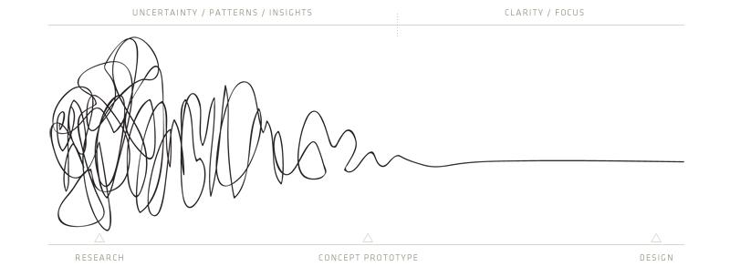
SREB Design Process
Ask/
Inquire
Improve
Imagine
Experiment/
Evaluate
Plan
Create

Slide 8
Project-Based Learning Assignments
Standards Based focusing on essential standards needed to master the project.
Enabling activities, just-in-time instruction and assessments are planned around a design process.
Assignments should involve Business/ Industry Partners when possible and based on authentic problem solving in the workplace.
CTE and Academic teachers collaborate on the project planning, feedback, delivery and reflection

Slide 9
Leaders Supporting Design

Slide 10
Leadership facilitates the following during the design process.
Teachers self-assess current projects to identify initial conditions.
1) Transform activities to projects.
2) Modify and enhance existing projects.
3) Create new projects.
Protected time to design in a collaborative setting.
Business and Industry Partnerships
Public Products
Notes:
Respect the work already done. Teachers do not need to start from scratch. This is leadership differentiating.
Protected and collaborative time. Circle of trust. CTE, Practical Arts, Academic Coaches, SPED, Workforce, Guidance.
Economic Development Meeting, Power Systems, MO Community College and Mizzou.
CACC Workplace Standards

Slide 11
Leadership Facilitating Self & Peer Assessment

Slide 12
Tours and Networking Extraction
1. Researching tours prior to visit.
http://maritime.aidt.edu/
http://www.columbiaredi.com/
http://www.boeing.com/principles/education/resources.page
http://www.fluidpowersupport.com/
2. Meeting to share vision and customize tour.
Partnership Options
1. Co-Design
2. Co-Implementation (Project Launch, Critique/Revision, Presentation)
3. Mock Interviews with Project to better Articulate Skills & Knowledge
3. Review aspects of industry with teachers prior to tour.
https://education.alaska.gov/tls/cte/docs/curriculum/all-aspects-of-industry.pdf
4. Interactive Notes for Industry Tours as part of a Professional Notebook
https://www.forbes.com/sites/dorieclark/2012/05/01/the-1-productivity-tool-you-arent-using/#23812bd13d00
5. Tour Debrief: Simulated Workplace
https://wvde.state.wv.us/simulated-workplace/
What can we mirror in the project? What can we use in our classroom?

Slide 15
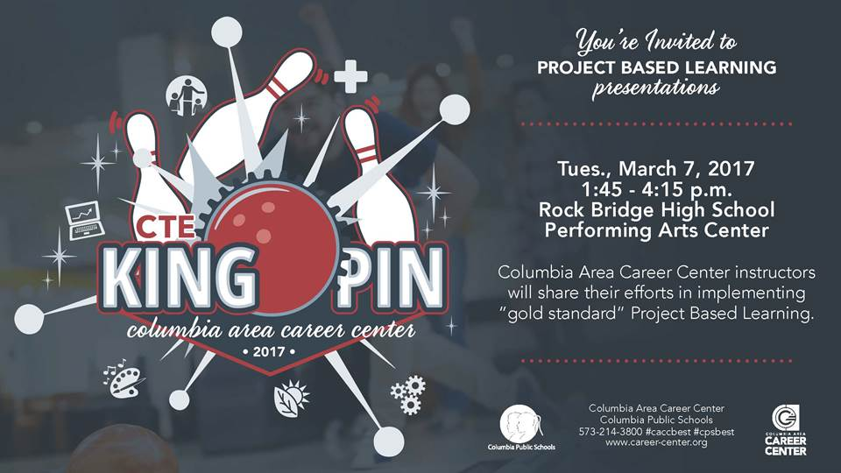
Public Product

Slide 16
Leaders Supporting Implementation

Slide 17
Structured Critique, Reflection, and Revision
Identify Instructional Team: Differentiated Coaching
3 Iterations: Critique, Revision, Reflection
Descriptive not Evaluative Feedback based on Rubric and Evidence
Front-loading and Scaffolding Instruction
Overtly Teaching and Assessing Employability Skills
Public Product: Open Mic Night
Cross-Pollination

Slide 18
Leaders bring all the experts and practitioners to the table.
Authentic Projects
Business/Industry and Postsecondary Partners
CTE Teachers
District and School Leadership and Support
Core Academic Coaches/Teachers

Slide 19
Descriptive Feedback
Constructive Feedback Prompts
“Gold Standard”
Design Elements Evidence
I like that ………!
Have you considered…..?

Slide 20
Frontloading and Scaffolding Teaching Methods
How can I overtly teach and assess employability skills from day 1?
How can I change or modify my instructional methods to better prepare students to complete a student-centered project?
“Just-in-time instruction” but must be out of context.

Slide 22
Leaders Supporting Management and Sustainability

Slide 23
Instructional Coaches: Essential Roles and Responsibilities
Practitioner
Research
Modeling
Differentiate
Reciprocity
Data Driven
Other
Practitioner | Walk the Walk: You must design projects individually and collaboratively. This allows the coach to share and model the journey.
Research | Theory to Practice: Share strategies and where they are connected to research. Document your sources.
Modeling | During training and coaching, we must be willing to model and strategies in the classroom for teachers. Co-teaching.
Reciprocity | We need to listen to our participants. We expect them to share tools, strategies, and resources as well.
Differentiate | Just like we expect teachers to differentiate with students. Not all teachers will be at the same place. We need to meet them where they are at.
Data Driven | Descriptive and NOT Evaluative. We are coaches and support a learning progression. We use rubrics to assess projects designs.
Other | Each school and district is unique. There may be other areas for coaching beyond these essential areas.
The pie chart below represents a sample of roles and responsibilities to effectively coach project-based learning. Although each pie slice is equal in size, we may need to emphasize specific slices depending on the needs of our teachers, school, and district.

Slide 24
Why Do Teachers Need Instructional Coaches? By Peter DeWitt
Working with an instructional coach doesn't mean that teachers are weak, it actually shows how strong they are because they believe they can always get better.
Great instructional coaches that have an impact on teaching and learning in the classroom learn as much from the teacher they work with as the teacher learns from the coach.

Slide 25
What Good Coaches Do by Jim Knight http://education.ky.gov/teachers/PGES/TPGES/Documents/What%20Good%20Coaches%20Do.pdf
Actions of Good Coaches
Seven Partnership Principles
Equality
Choice
Voice
Reflection
Dialogue
Praxis
Reciprocity
They enroll teachers.
The identify teacher goals.
They listen.
They ask questions.
They explain teaching practices
(modeling and co-teaching)
Observations only on teacher request. To ensure trust, the teacher-coach relationship avoids observation, evaluation, and judgement.

Slide 26
Project Library
24-7-365 access
Virtual design
(google docs)
Rigorous Assignments

Slide 27
Differentiated Support
Tier 3
Simulated Workplace & Cross-CTE Projects
Tier 2
Design and Implement a Sequence of Projects
Tier 1
Design and Implement a Project
Targeted Professional Develop
Tier 1
Tier 2
Tier 3

Slide 28
Building a Depth Chart
Coaching your Replacement
Vertical Alignment to Build Pathways
Practical Arts and Feeder Schools
Moberly Community Colleges
Hiring Practices and New Teacher Training
Data Collection to Drive Decisions

Slide 29
QUESTIONS?
To contact us:
RGooch@cpsk12.org
Marty.Sugerik@sreb.org

Slide 30
All files and additional resources
Google Folder: bit.ly/Resources-PBL
and
Padlet: http://bit.ly/SREBPBL
For additional information about any Project-based Learning in Career Pathways, please contact SREB Manager
Sandy.Cullota@sreb.org

