Slide 1
Supporting Low-Income Students in College Admission and Enrollment
SREB Go Alliance
April 22, 2020

Slide 2
Andrew Moe, Ed.D.
Director of Admissions
Swarthmore College

Slide 3
Breaking Down Barriers for Low-Income Students
Macro-Barriers - systemic & structural
School funding models
Low pay for teachers/counselors
Concentrated & generational poverty
Quality of early academic preparation
Lack of family education opportunities
Predatory practices of for-profits in low-income neighborhoods
Neighborhood segregation
Lack of college preparatory curriculum
Lack of high-speed Internet (broadband) in rural areas and small towns
Deficit in highly valued forms of social and cultural capital
Institutionalized racism
Lack of counselor training in grad programs
Lack of funding for professional development

Slide 4
Breaking Down Barriers for Low-Income Students
Micro-Barriers - logistical & organizational
College application fees
Standardized testing requirements and fees
Standardized testing score report sends
Visiting campuses
Admissions officers not visiting high schools
Lack of information (good, sound information)
Exposure to majors and careers
Ability to interpret financial aid award letters
Enrollment deposits and housing deposits
Adequate transition and preparation for college life

Slide 5
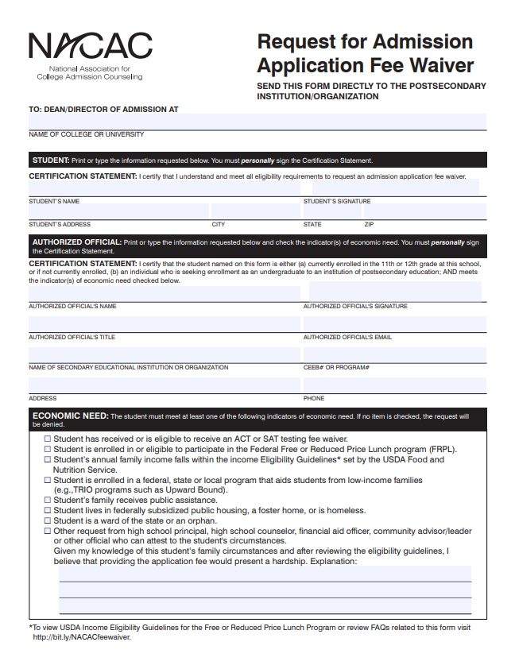
NACAC Resources
Request for Admission Application Fee Waiver
ACT/SAT fee waiver eligible
Federal Free or Reduced Priced Lunch
Annual income eligibility
Enrolled in TRiO programs (i.e., Upward Bound)
Public assistance, public housing
Foster care, ward of the state, homeless, orphan
Official (school principal, counselor, community advisor) can support this request

Slide 6
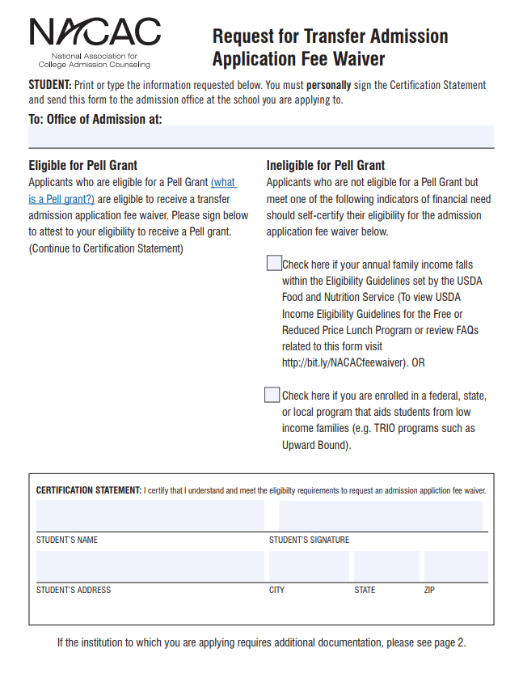
NACAC Resources
Request for Transfer Admission Application Fee Waiver
Pell Grant eligible
Federal Free or Reduced Priced Lunch
Annual income eligibility
Enrolled in TRiO programs (i.e., Upward Bound)

Slide 7
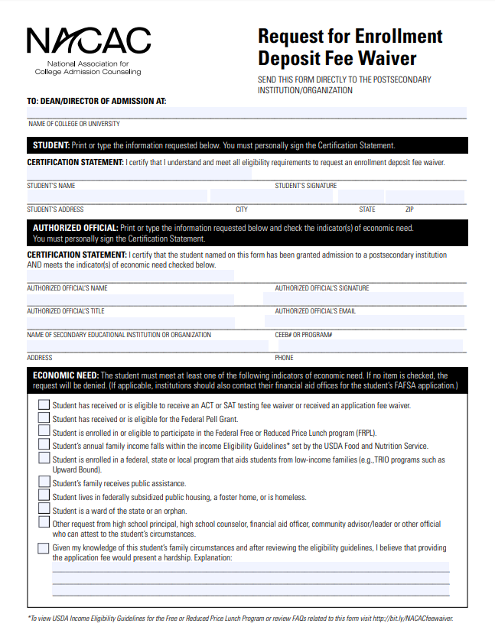
NACAC Resources - New!
Request for Admission Application Fee Waiver
Pell Grant eligible
ACT/SAT fee waiver eligible
Federal Free or Reduced Priced Lunch
Annual income eligibility
Enrolled in TRiO programs (i.e., Upward Bound)
Public assistance, public housing
Foster care, ward of the state, homeless, orphan
Official (school principal, counselor, community advisor) can support this request

Slide 8
Application Fee Waiver Matrix
bit.ly/CollegeAppWaivers

Slide 9
Swarthmore Application Fee Waivers
Junior or Community College Transfers
Veterans or U.S. Military Personnel
Students enrolled at high-poverty high schools
Students coming from low & medium development countries
Nominated for or applied to fly-in program
Common Application Fee Waiver
Coalition Application Fee Waiver
QuestBridge Application
Self-identified through SwatPass

Slide 10
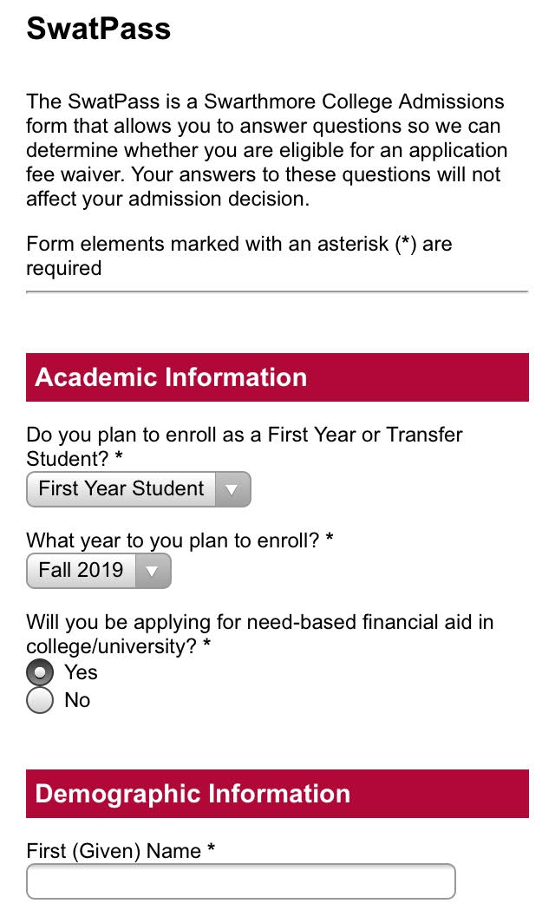
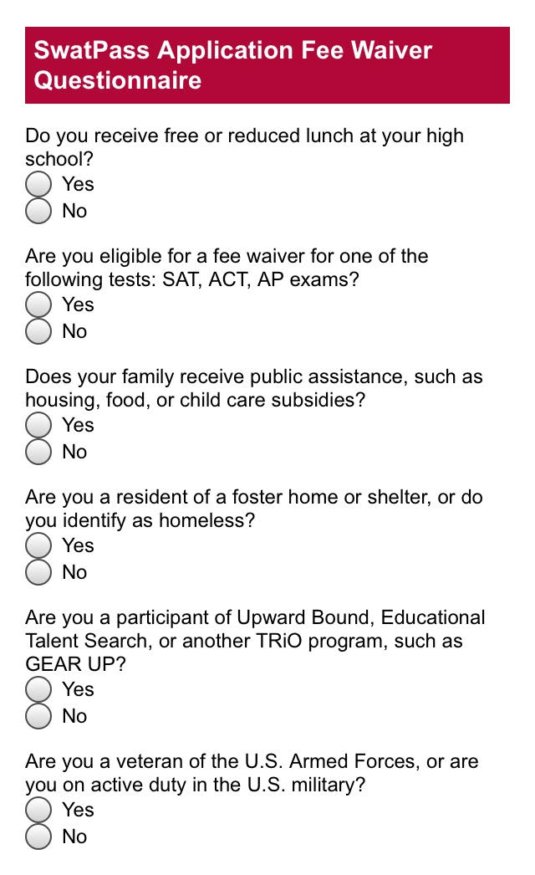

Slide 11
Questions?

