Slide 1
Advocacy Training: Delivering Culturally Sensitive Care to LGBT+ Patients
Jessica Landry, DNP, FNP-BC
Todd Tartavoulle, DNS, APRN, CNS-BC

Slide 2
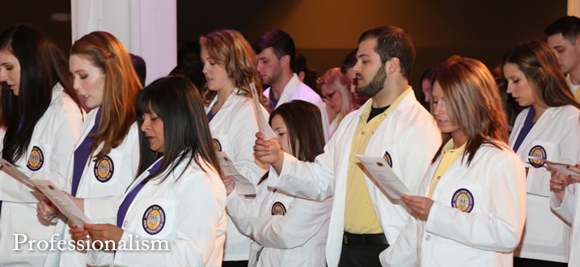
Mission
The mission of the Advocacy Program is to be leaders in integration of, inclusion and equity to ameliorate health inequalities and create affirming healthcare environments

Slide 3
Goals
Provide diversity educational and training programs for different specialties.
Integrate components of psychosocially safe spaces during all training sessions.
Teach respectful communication skill in obtaining medical histories, and providing culturally competent care for all individuals, families, and communities.
Continue partnership with Gay Alliance and Safe Zone to conduct training to non-healthcare agencies.

Slide 4
Activities
Understanding the Need
“I treat everyone the same”
Tips for Facilitator Success
Introductions

Slide 5
Activities
Vocabulary Match up Game
Creating Inclusive Spaces in the Workplace
Creating Inclusive Spaces for Patients
Understanding the Cass Model

Slide 6
Activities
Myths and Stereotypes for Healthcare Professionals
Gender Fluidity
Psychologically Safe Spaces
Communicating Respectfully in Healthcare

Slide 7
Who have we reached?
Over 700 nursing students
3 schools of nursing in southeast LA
1 nursing school in Northeast
Over 100 faculty at 2 schools of nursing
Train the trainer
50 hospital administrators Southeast LA hospital

Slide 9
Attitudes

Slide 11
Facts

Slide 12
Plan of Care

Slide 13
Terminology

Slide 14
Qualitative Comments
“The training really brought my thinking to a place of reality.”
“I believe I have always been open & tolerant to LGBT+ community but knowing more about their life before transition opens my eyes to be more sensitive.”
“The steps of coming out was new and will help me frame my interactions with patients.”
“The training helped me become more self aware of personal feelings and biases.”

Slide 15
Questions ??

