Slide 1
Improved Student Outcomes through Transformation of Geriatric Course Delivery
Cheryl A Tucker, DNP, RN, CNE
Kelly Rossler, PhD, RN, CHSE
Panel Presentation
Southern Regional Education Board
2018 Annual Conference of the Council on Collegiate Education for Nursing

Slide 2
Program Objective
Integrate new tools, including technology and simulation applications and active learning models, into nursing education in ways that promote greater student engagement and better outcomes, and transform learning

Slide 3
Historical Perspective
Curricular Challenges in a Geriatric Course
Course Objectives
Incongruency between Theory and Learning Activities
Course Gaps and Overlaps
Guest Speakers
Student Evaluation of Instruction

Slide 4
A Transition with Learning: Methodology
Online Engaged Learning Environment
Simulation Learning Experience
Service Learning Project

Slide 5
Online Engaged Learning Environment
Internet Based Case Studies
Video Vignettes
Electronic Books
Recorded Mini-Lectures
Unit Quizzes
Service Learning Presentations

Slide 6
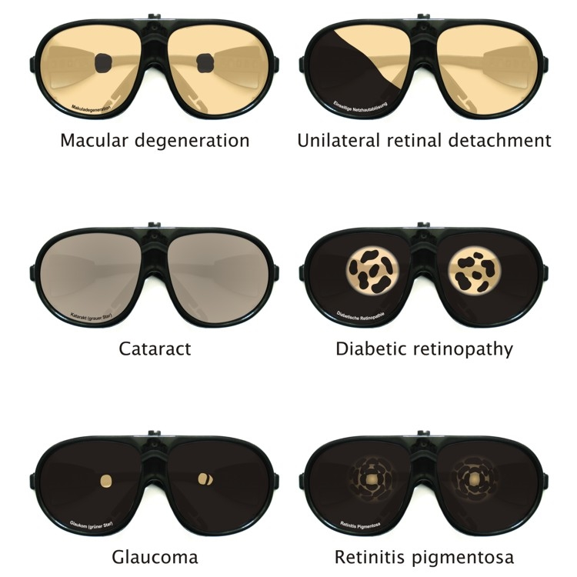
Simulation Learning Experience
GERT Simulation Suit & Eye Diseases
(Moll, 2018)

Slide 7
Simulation Learning Experience

Slide 8
Simulation Learning Experience
National League for Nursing: ACEZ Case #1 Judy Jones
Simulation Roles:
Assessment, Medication, Procedure, Documentation, Observer
Tools for Assessment
Confusion Assessment Method (CAM)
Mini-Cog© Screening: Cognitive Impairment in Older Adults
Beers Criteria: Potentially Inappropriate Medication Use in Older Adults (American Geriatric Society, 2015)
Modified Caregiver Strain Index (MCSI)
Reflective Journaling
(National League for Nursing, 2014; The Hartford Institute for Geriatric Nursing, NYU College of Nursing, 2007)

Slide 9
Service Learning Project
Acts of Kindness & Justice
Yardwork
Painting
Housekeeping
Cleaning out barns and sheds
Exercise Classes for Older Adults
Medication Education
Home Safety Checks

Slide 10
Outcome Measures: HESITM Exam Scores
HESI Med/Surg Specialty Exam Score: Specialty Area Geriatrics
Academic Year | Fall HESI Score | Spring HESI Score
Academic Year 2017-2018 | 892 (N=67 in 2017) | 944 (N=130 in 2018)
Academic Year 2016-2017 | 1072 (N=67 in 2016) | Score Not Provided by HESI (N=126 in 2017)
Academic Year 2015-2016 | 934 (N=57 in 2015) | 953 (N=115 in 2016)
Academic Year 2014-2015 | 864 (N=72 in 2014) | 798 (N=81 in 2015)
(Nibert & Morrison, 2013; Zweighaft, 2013)

Slide 11
Conclusion
Infusion of innovative technologies improved student outcomes
Feasible in a hybrid format
Students engage and take ownership of learning
Geriatric simulation created realism and empathy for older adults
Expansion of learning into the community

Slide 12
References
American Geriatric Society. (2015). American Geriatrics Society 2015 updated Beers Criteria for potentially inappropriate medication use in older adults. Journal of American Geriatric Society, 63, 2227–2246. doi: 10.1111/jgs.13702
Moll, W. (2018). Age simulation suit GERT [Brochure]. Niederstotzingen, Germany: Produkt & Projekt. Retrieved from http://www.age-simulation-suit.com/usa-canada
National League for Nursing. (2014). Instructor’s toolkit for Judy Jones simulations. ACE.Z Advancing care excellence for Alzheimer’s patients and caregivers series. National League for Nursing: Author.
Nibert, A., & Morrison, S. (2013). HESI Testing—A history of evidence-based research. Journal of Professional Nursing, 29(2), S2-S4. doi:10.1016/j.profnurs.2012.06.004
The Hartford Institute for Geriatric Nursing, NYU College of Nursing. (2007). How to Try This series. Retrieved from https://hign.org/
Zweighaft, E. L. (2013). Impact of HESI specialty exams: The ninth HESI exit exam validity study. Journal of Professional Nursing, 29(2), S10-S16. doi:10.1016/j.profnurs.2012.06.011

