Slide 1
Developing a State-Wide Teaching Academy for Undergraduate Adjunct Faculty
Kelley Miller Wilson DNP, MSN, CMSRN

Slide 2
Objectives:
Identify the process/rationale for a clinical teaching academy using online modules and a single four hour simulation.
Review training processes and instructional support for adjunct clinical faculty in the UG program.
Examine feedback challenges clinical instructors face in clinical situations.
Review evaluation criteria for the program.

Slide 3
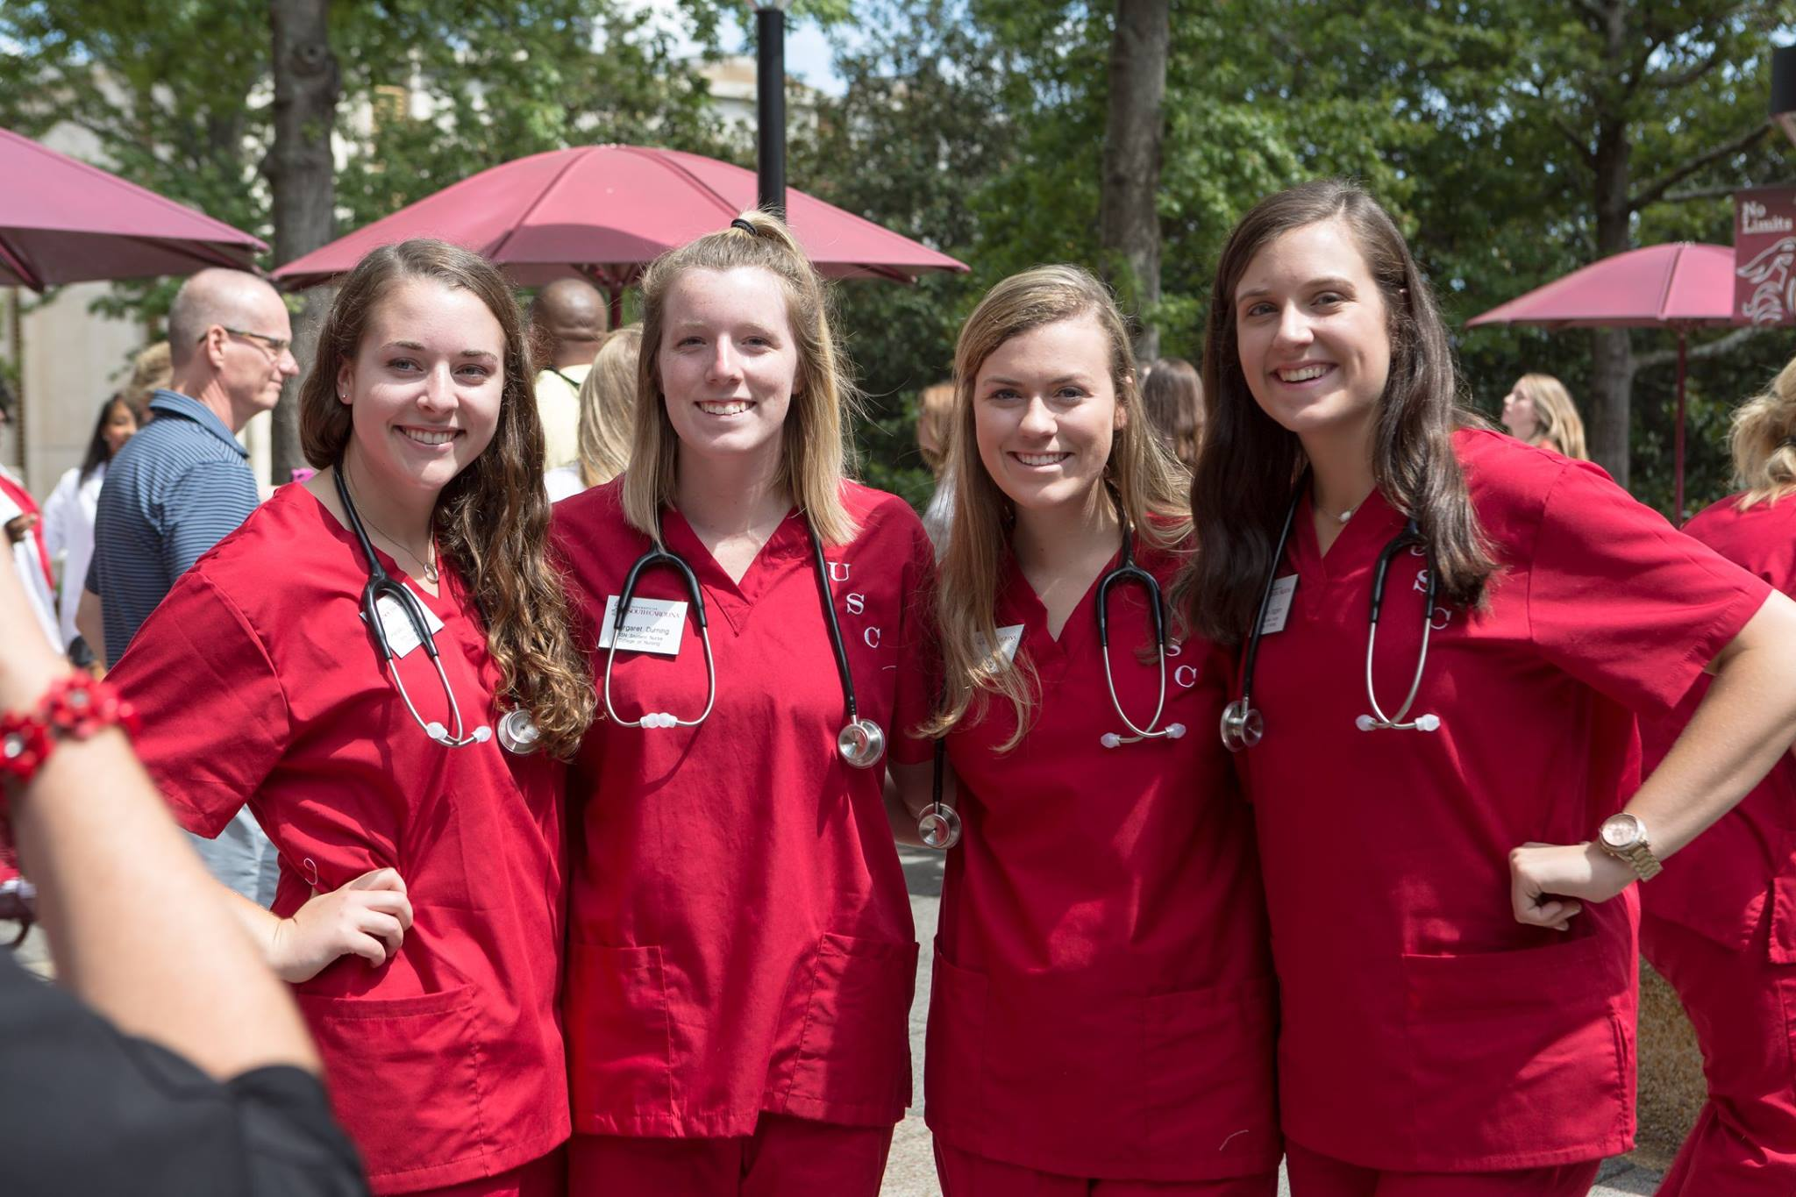
Nationally identified Trends
Adjunct clinical faculty, high levels of clinical expertise though often limited formal training in nursing education. (3,4)
Skills needed include:
Creating appropriate patient-student assignments
Implementing best practice teaching strategies
Documenting and evaluating performance
Providing feedback
Mentoring

Slide 4
Why is it so important to consider formal training for adjunct faculty?
Preparing to meet the workforce demands
Addressing the Nursing Faculty shortage
Innovation and best practices to train and equip adjunct faculty

Slide 5
Adjunct Faculty:
Assess, evaluate and facilitate in clinical settings.
Integral to growth of nursing graduates entering the workforce.
Help develop clinical reasoning and critical thinking. (1)
Competency in clinical teaching has shown significant association with final semester success and NCLEX pass rates (2)
Help address the nursing faculty shortage

Slide 6
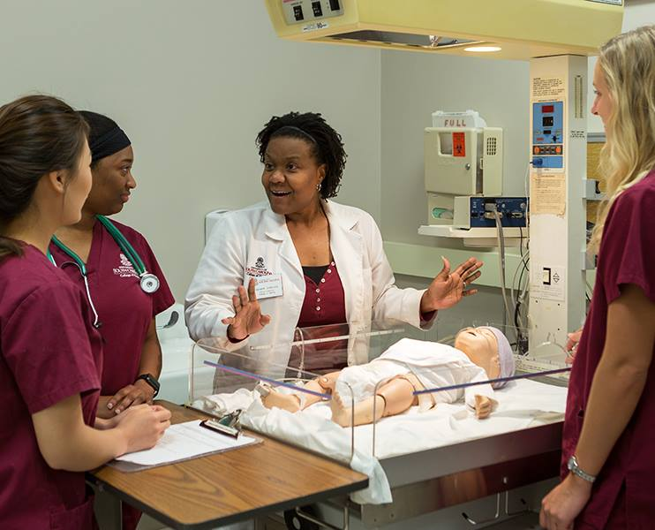
Identified Limitations
Time
Resources both personnel and financial
Training availability, expertise and sites
Commitment

Slide 7
Promise of Nursing Grant
Goal of the Project: Develop and implement a Clinical Teaching Academy that provides faculty development and instructional support to adjunct clinical faculty in the Undergraduate program.
(This presentation will focus
On the feedback portion of our grant)

Slide 8
Planned Clinical Teaching Academy
The program will provide:
Faculty development and instructional support to adjunct faculty in the undergraduate program
Offered at the start of every semester to all adjunct undergraduate clinical faculty
Mandatory attendance within 6 months of employment
Using theory and evidence based approaches, the academy will serve as a hybrid training program focusing on the NLN Nurse Educator Core Competencies related to clinical teaching

Slide 9
Three Components of Education:
Six on-line, asynchronous learning modules
One four-hour face-to-face, simulation enhanced experiential leaning session with trained facilitators
Online community of practice for on-going support

Slide 10
Teaching Capacity Enhanced
Increase number of instructors trained in best practices of clinical instruction
Increase teaching capacity in diverse clinical settings
Improve quality/quantity of nursing graduates entering the workforce
Improve resource access to rural campuses with minimal teaching resources
Benefit to practice partners; skill sets transfer to mentorship and preceptorship

Slide 11
Outcome Measurement
Three objectives for the grant:
Develop 6 online asynchronous modules
Design a four hour simulation with hands on practice
Establish an online forum to build a community of practice among adjunct faculty.

Slide 12
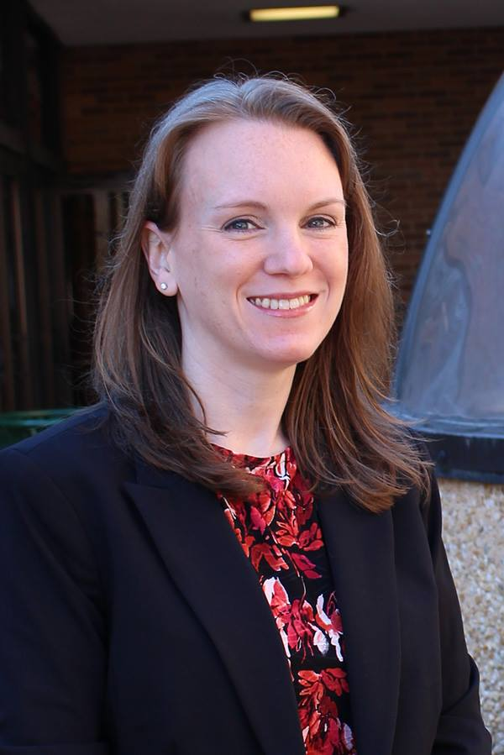
Sustainability and Dissemination
Grant funding to support initial development
The PI will continue to lead training, further development and outcome assessments
Consider tuition assessment in the future to continue to support the program needs

Slide 13
2 student Examples
Kara and Rochelle
Using a BEER-C Conversation model taught in the modules and practiced during the simulation; adjunct faculty counsel a “real” student.
B- Behavior
E- Effect
E- Expectation
R- Result
C- Collaborated/Coach

Slide 14
Kara

Slide 15
The Issue……

Slide 16
Counseling Session With Kara
Kara, I noticed you have been 2 hours late in documenting your morning assessment the last two clinical days (B).
When this happens , other team members do not have access to the most up-to-date status on your patient, which jeopardizes patient safety (E).
The expectation is that you will document your 0800 vitals and assessment by 1000 every shift, unless an emergent issue arises, in which case you need to notify me (E).
By providing timely documentation, we are helping to provide critical information upon which others base decisions and enhance patient safety (R ).
What are your thoughts about how to improve this moving forward? (C )

Slide 17
Rochelle

Slide 18
The Issue….

Slide 19
Counseling Session with Rochelle
Rochelle, it was apparent that you were not prepared to give your patient medications today (B).
When you are unprepared to give medications, we have to take time to look up medications, review them and it makes our medication administration late, beyond the accepted time frame (E)
The expectation is that you are prepared to give your patient medications at least 30 minutes prior to the scheduled administration time unless an urgent situation arises, in which case you need to notify me. (E)
By providing medications in a timely manner, it provides the patient the greatest benefit from the medication and we enhance their chance for recovery (R)
What are your thoughts on how to better prepare for medication administration in a timely manner on future clinical days? (C )

Slide 20
In Summary:
Grant focus to support UG education needs with adjunct faculty in the clinical area
Teaching Academy designed on-line (6 modules) and 4 hour simulation
BEER-C model used to help adjunct faculty learn and practice counseling

Slide 21
Questions/Comments

Slide 22
References
1. Benner, P., Sutphen, M., Leonard, V., & Day, L. (2010) Educating nurses: A call for
radical transformation. San Francisco, CA: Jossey-Bass.
2. Leslie, B.M. (2016). The relationship between clinical curriculum and first time
NCLEX-RN success: A correlation study. Retrieved from ProQuest Digital
Dissertations. (10148327)
3. Cangelosi, P.R., Crocker, S., & Sorrell, J.M. (2009). Expert to novice: Clinicians
learning new roles as clinical nurse educators . Nursing Education Perspectives,
30(6), 367-371.
4. Gardner, S.S. (2014). From learning to teach to teaching effectiveness: Nurse
educators describe their experiences. Nursing Education Perspectives, 35(2),
106-111.

Slide 23
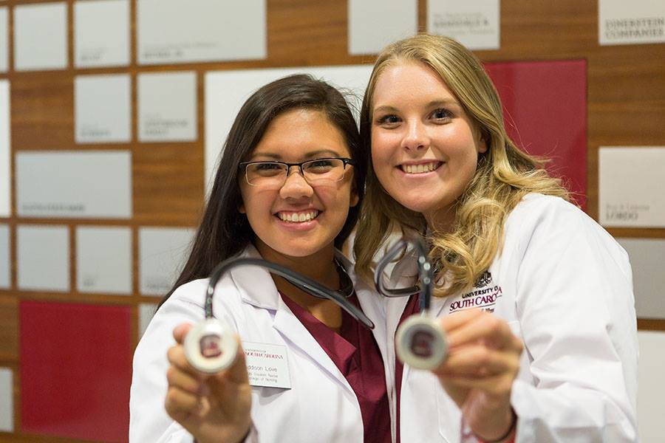
References (Continued)
5. West, M.M., Borden, C., Bermudez, M., Hanson-Zalot, M., Amorim, F., &
Marimion, R. (2009). Enhancing the clinical instructor adjunct role to benefit
students. The Journal of Continuing Education in Nursing, 40(7), 305-310.
6. McDonald, P.J. (2010). Transitioning from clinical practice to nursing faculty:
Lessons learned. Journal of Nursing Education, 49(3), 126-131.
7. Forbes, M.O., Hickey, M.T., & White, J. (2010). Adjunct faculty development:
Reported needs and innovative solutions. Journal of Professional Nursing,
26(2), 116-124.

