Slide 1
Preparing Pre-Licensure Nurses: An Interprofessional Disaster Drill
Jean Ellen Zavertnik, RN, DNP, CNE, CHSE
Clemson University School of Nursing

Slide 2
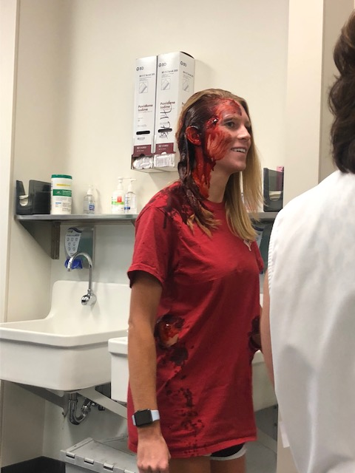
Mass Casualty Shooter Drill
First responders; Fire, Police, EMS
Medical Students, Faculty
Nursing Students, Faculty
Hospital Professional

Slide 3
Objectives
Gain insight/empathy for casualty participants in a disaster
Enhance understanding of roles and responsibilities of law enforcement, fire service, and emergency medical services responding to a mass casualty incident
Describe, from a personal perspective, casualty participant-first responder interactions with an emphasis on caring (providing comfort; building trust; and instilling hope)

Slide 4
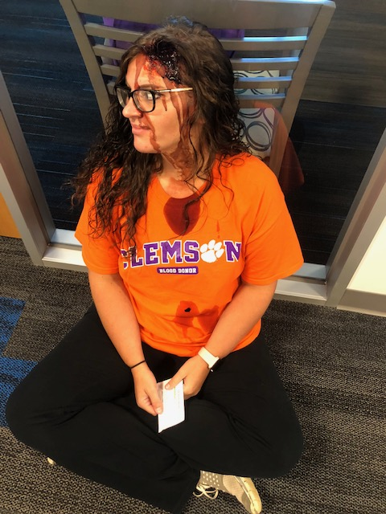
Description

Slide 5
Questions for the audience:
What insights can nursing students gain by participating in a disaster drill?
What caring behaviors are demonstrated in a disaster drill?
Can participation in a simulated disaster drill help students to gain an appreciation of the role of first responders?

Slide 6
Method and Metrics
Two surveys
One week post experience
Optional
IRB approved
Mixed methods
Quantitative: mean, median, mode, range, and standard deviations
Qualitative: thematic analysis

Slide 7
Caring Of the 50 student respondents, more than half (82%) of the participants observed acts of caring during the simulation, particularly from EMT (76%) and police (44%).
Results

Slide 8
First Responder Interactions with first responders provided nursing students a better understanding of first responder role and responsibilities (56%), however 17% of the nursing students did not see the role of the first responder differently following the simulation, 16% were undecided.
Results

Slide 9
teamwork and collaboration communication reaction and behavior triaging procedure importance of disaster drills and Interprofessional training
Themes

Slide 10
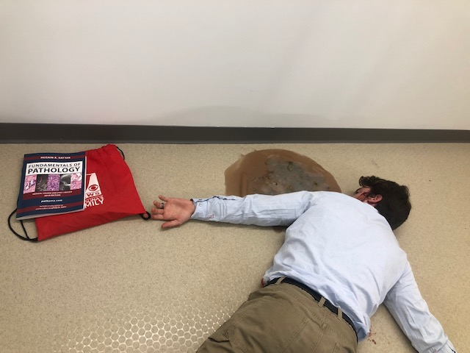
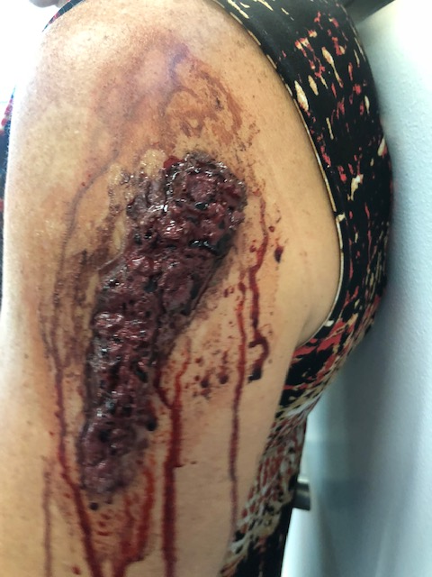
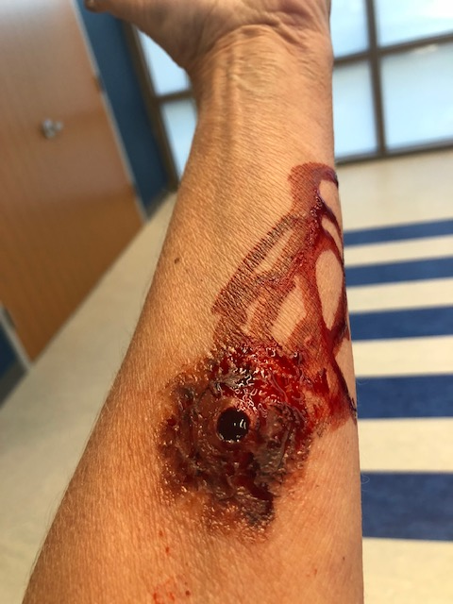
Significance
Preparing pre-professional nursing student for disaster can lead to positive learning outcomes and facilitate transition to practice in the community health nursing setting.

Slide 11
Implications , Limitations, Replication
The impact of exposing pre-professional healthcare students to a disaster may not be fully realized until specific data collection tools are available, however, playing the role of a casualty participant may allow the nursing students to gain insight into the importance of preparing for a disaster, empathy for disaster victims, and appreciate the role of emergency personnel in a disaster.

Slide 12
References:
Foisy-Doll, C. & Leighton, K. (2018). Simulation Champions Fostering Courage, Caring, and Connection. Wolters Kluwer: Philadelphia.
Interprofessional Education Collaborative. (2016). Core competencies for interprofessional collaborative practice: 2016 update. Washington, DC: Interprofessional Education Collaborative.
Sanchez, L., Young, V., & Baker, M. (2018). Active shooter training in the emergency department: A safety initiative. Journal of Emergency Nursing. (in press), https://doi.org/10.1016/j.jen.2018.07.002

